Slide 1
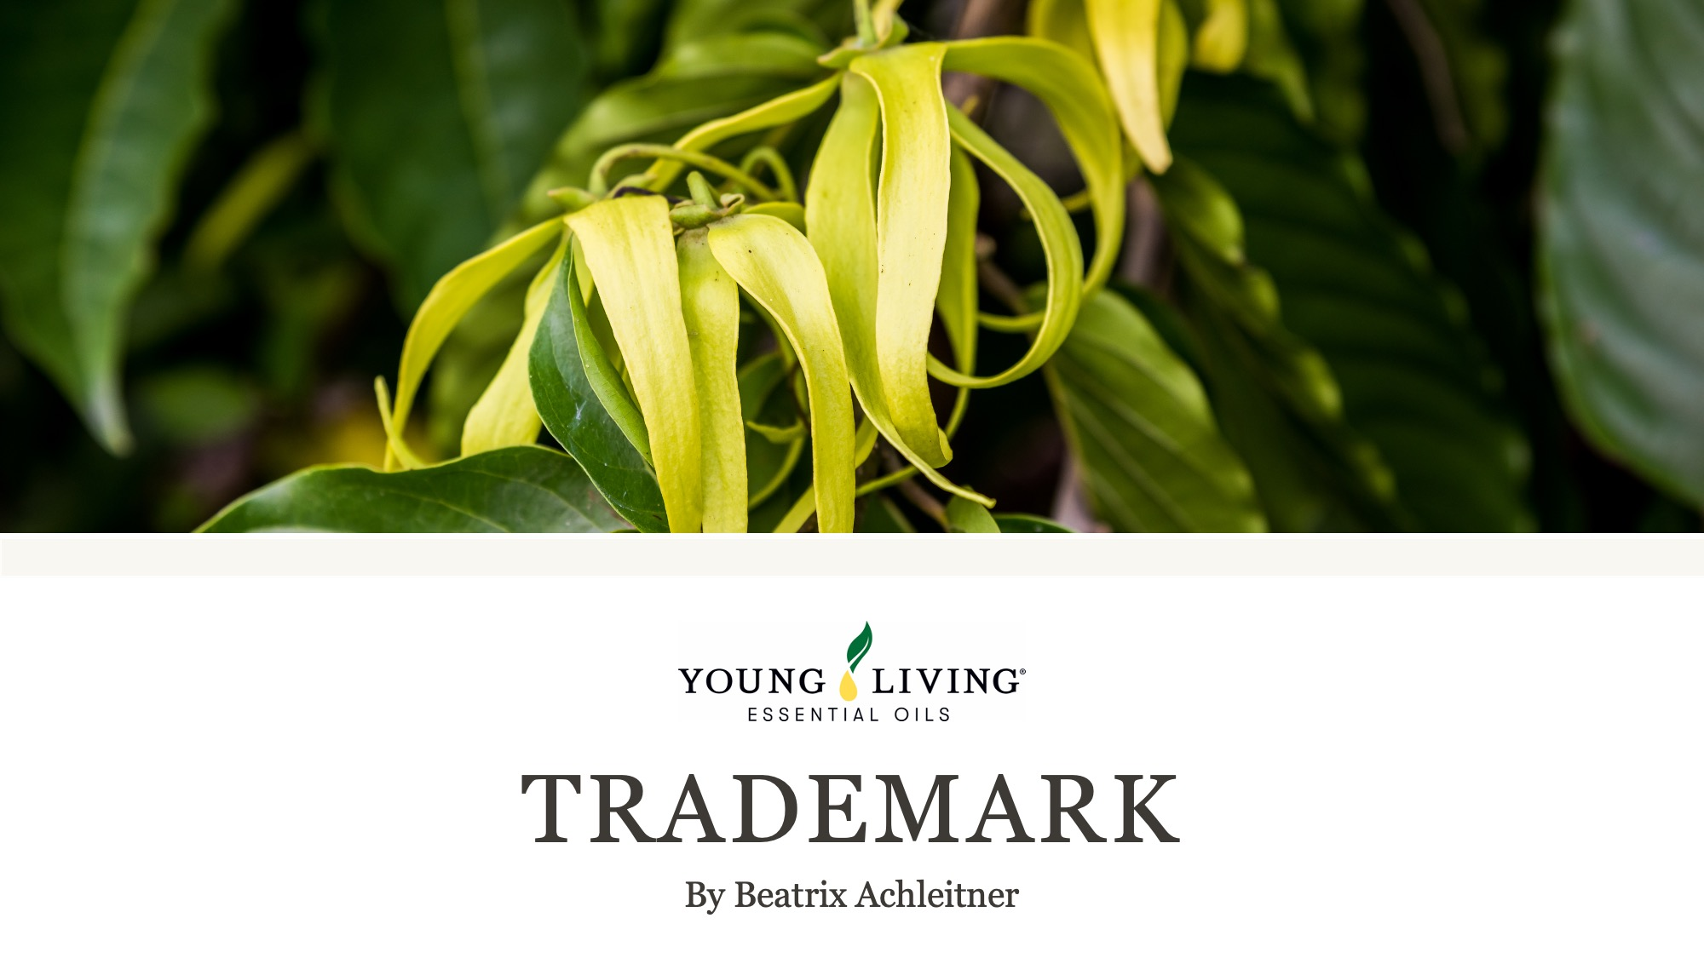

Slide 2
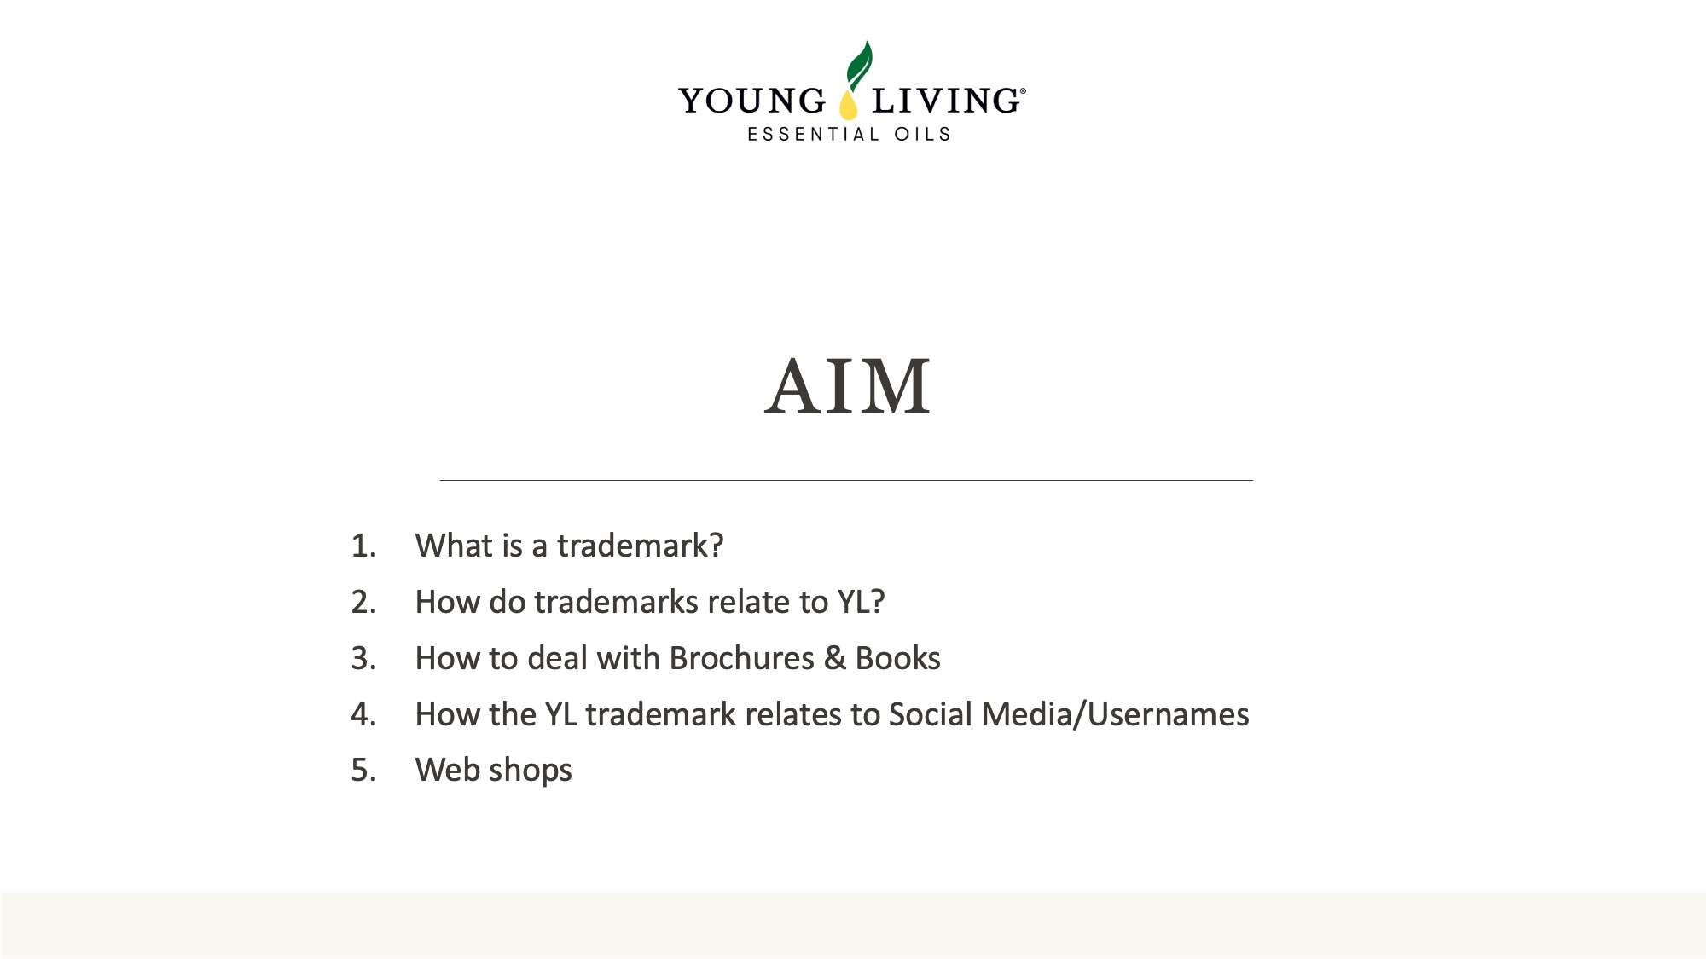

Slide 3
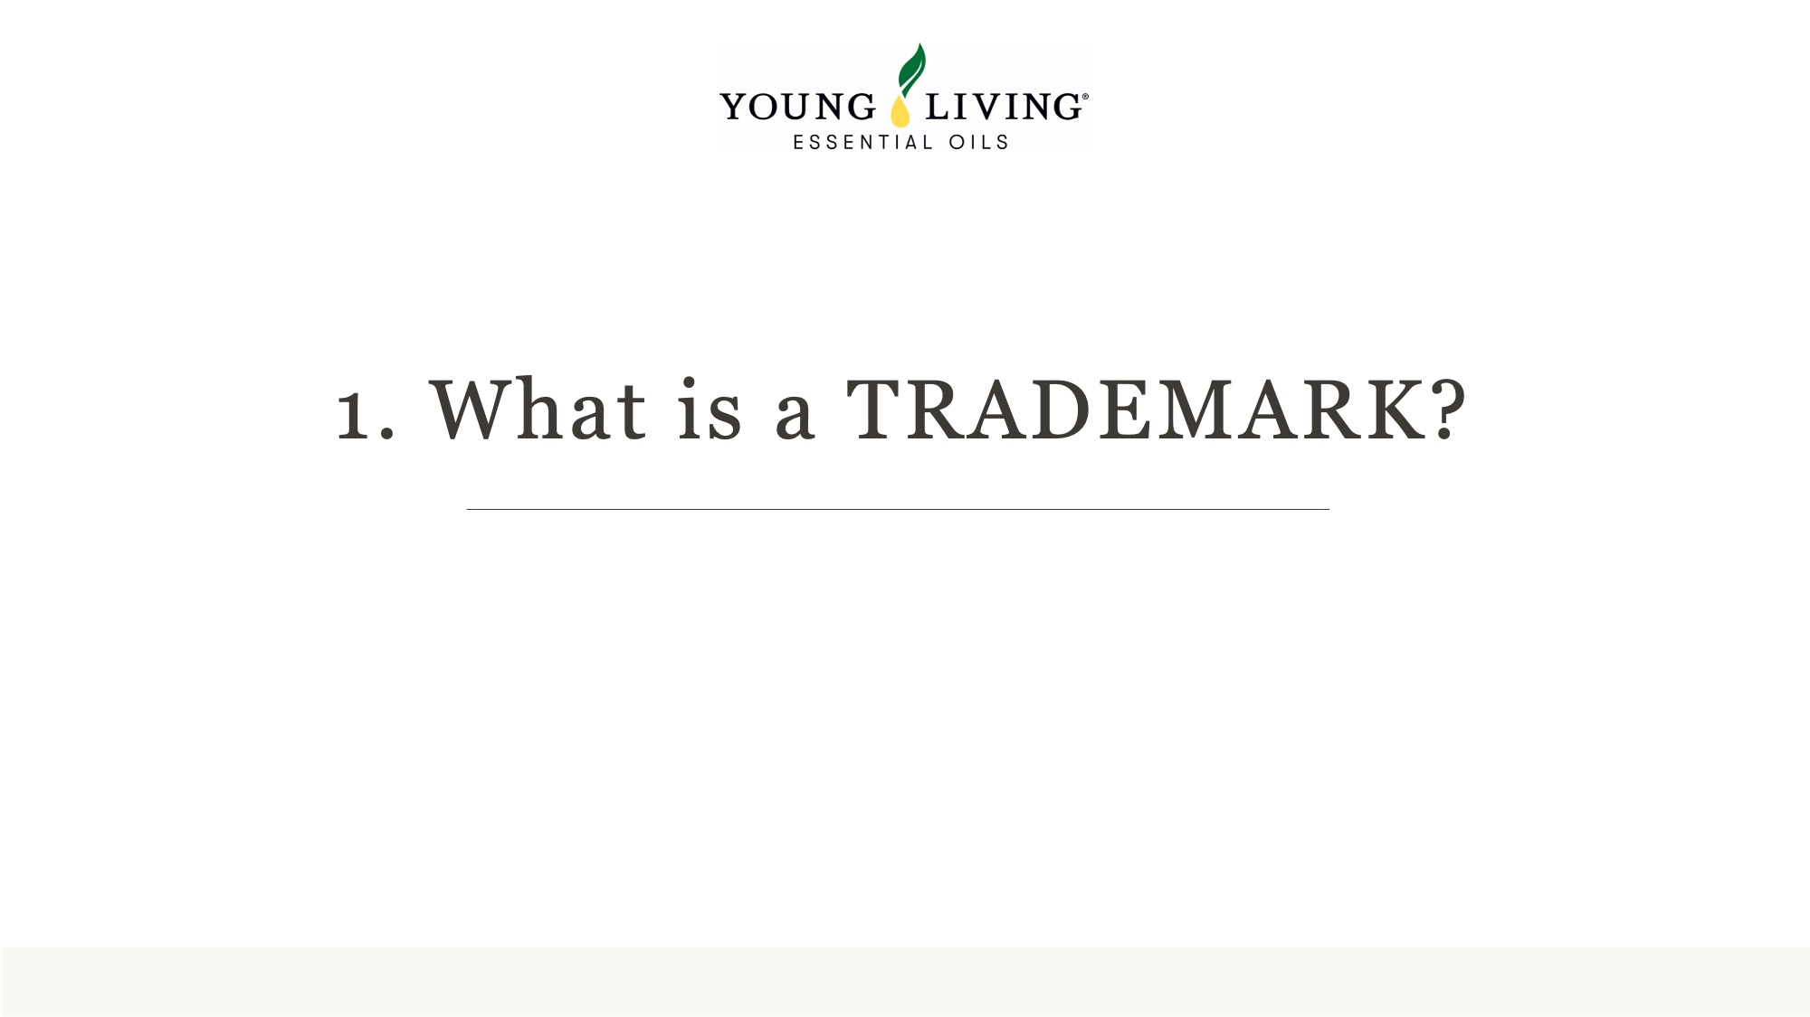

Slide 4
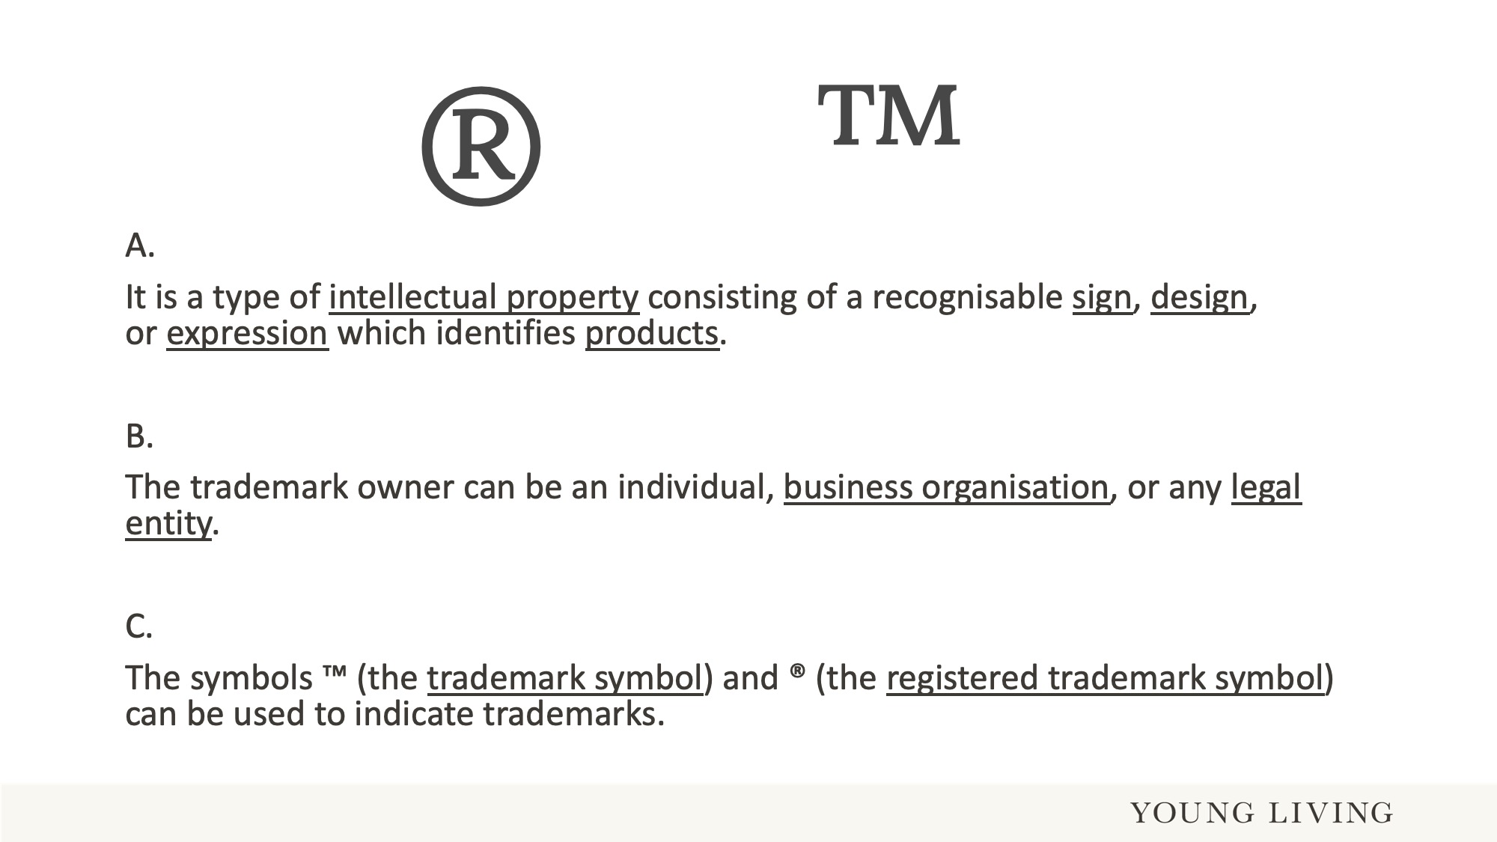
Notes:
Registering a trademark gives exclusive rights over ​distinctive signs​ – such as names, logos, colours, images, patterns, shapes, packaging of goods, or sounds – which identify the products and distinguish the goods or services from others.
The “R” symbol in the circle used for the registered Trademark. If you do use the registered trade mark symbol (®) without having registered the mark, it is seen as misleading and deceptive. If you are challenged over it, you could be subject to severe penalties.
The “TM” symbol is used when the Trademark application is filed with the trademark registry, but is yet unregistered.
While most countries recognise the ® designation, the ™ is mostly a product of the English common-law system. This means that ™ is often seen on products in the United States and Australia but does not hold much weight in many countries around the world.
The Copyright symbol generally is written as “c” in the inside of a circle which is recognised around the world as a Copyrighted work, but there is no registration.

Slide 5
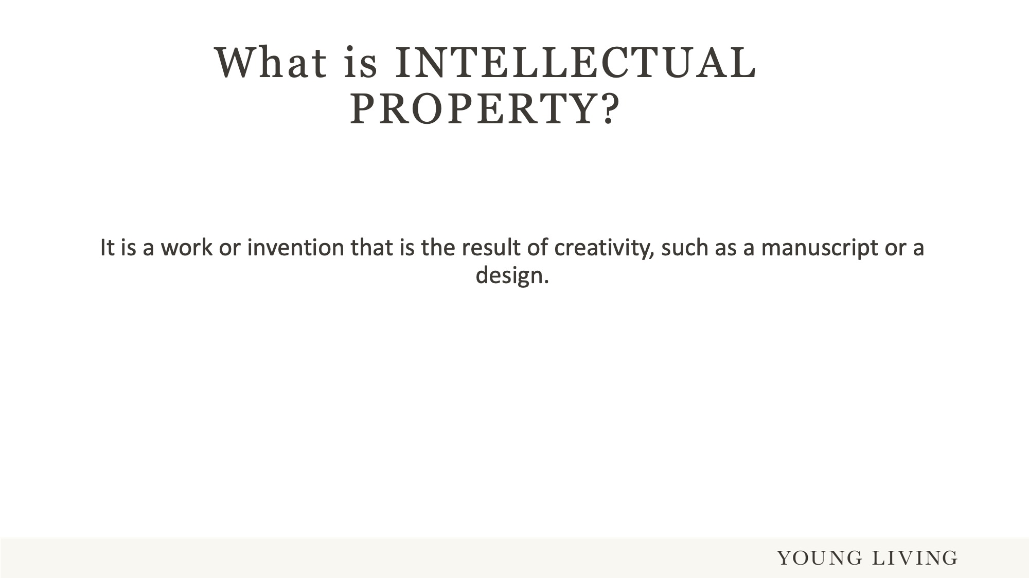
Notes:
You heard about “Intellectual Property” on the last slide.
Intellectual property rights - such as patents, trademarks, designs, copyrights or geographical indications - enable inventors, creators and businesses to prevent unauthorised exploitation of their creations, and to receive compensation for their investment.

Slide 6
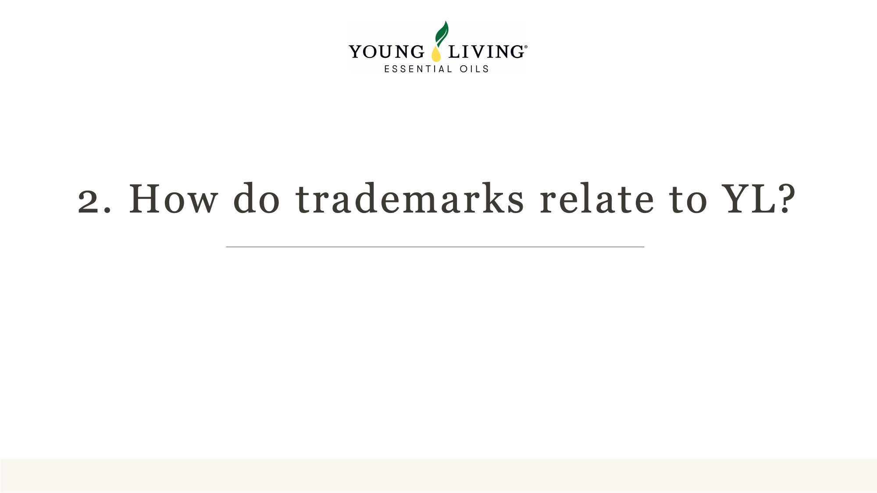

Slide 7
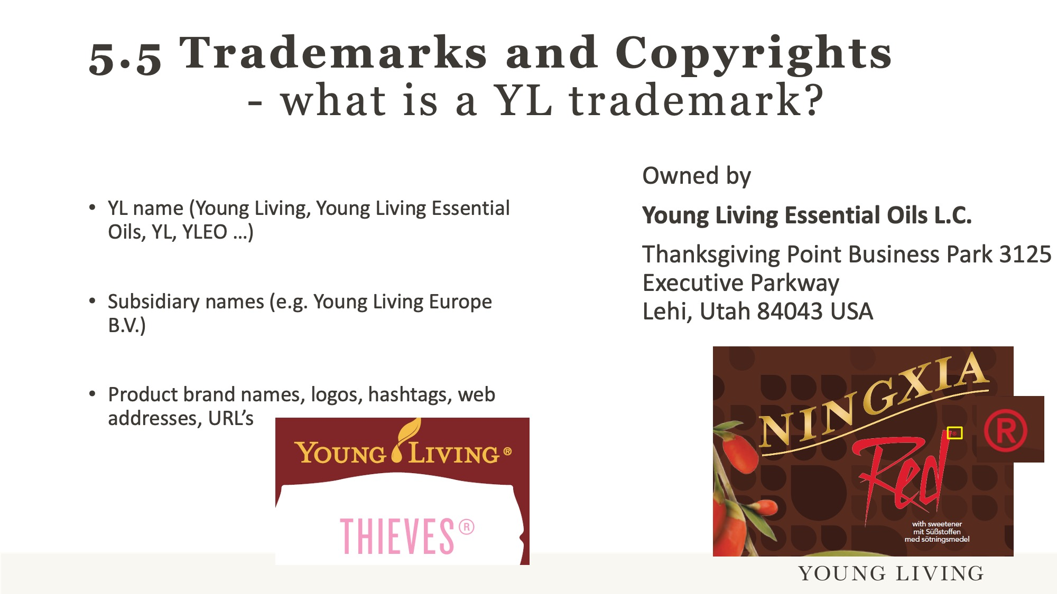
Notes:
In Europe we use the “R” to register trademarks. Examples are “Thieves” and NingXia Red”
Even if a “name”, be it a product name, logo or corporate designation, is not registered, it is STILL a name/designation owned by YL.
“Raindrop Technique”, as in these two words is a registered trademark (“R”). However, if someone only uses “Raindrop”, without the Technique, the single word is not protected. It is too general a word and therefore cannot be registered as a trademark by one person or company.

Slide 8
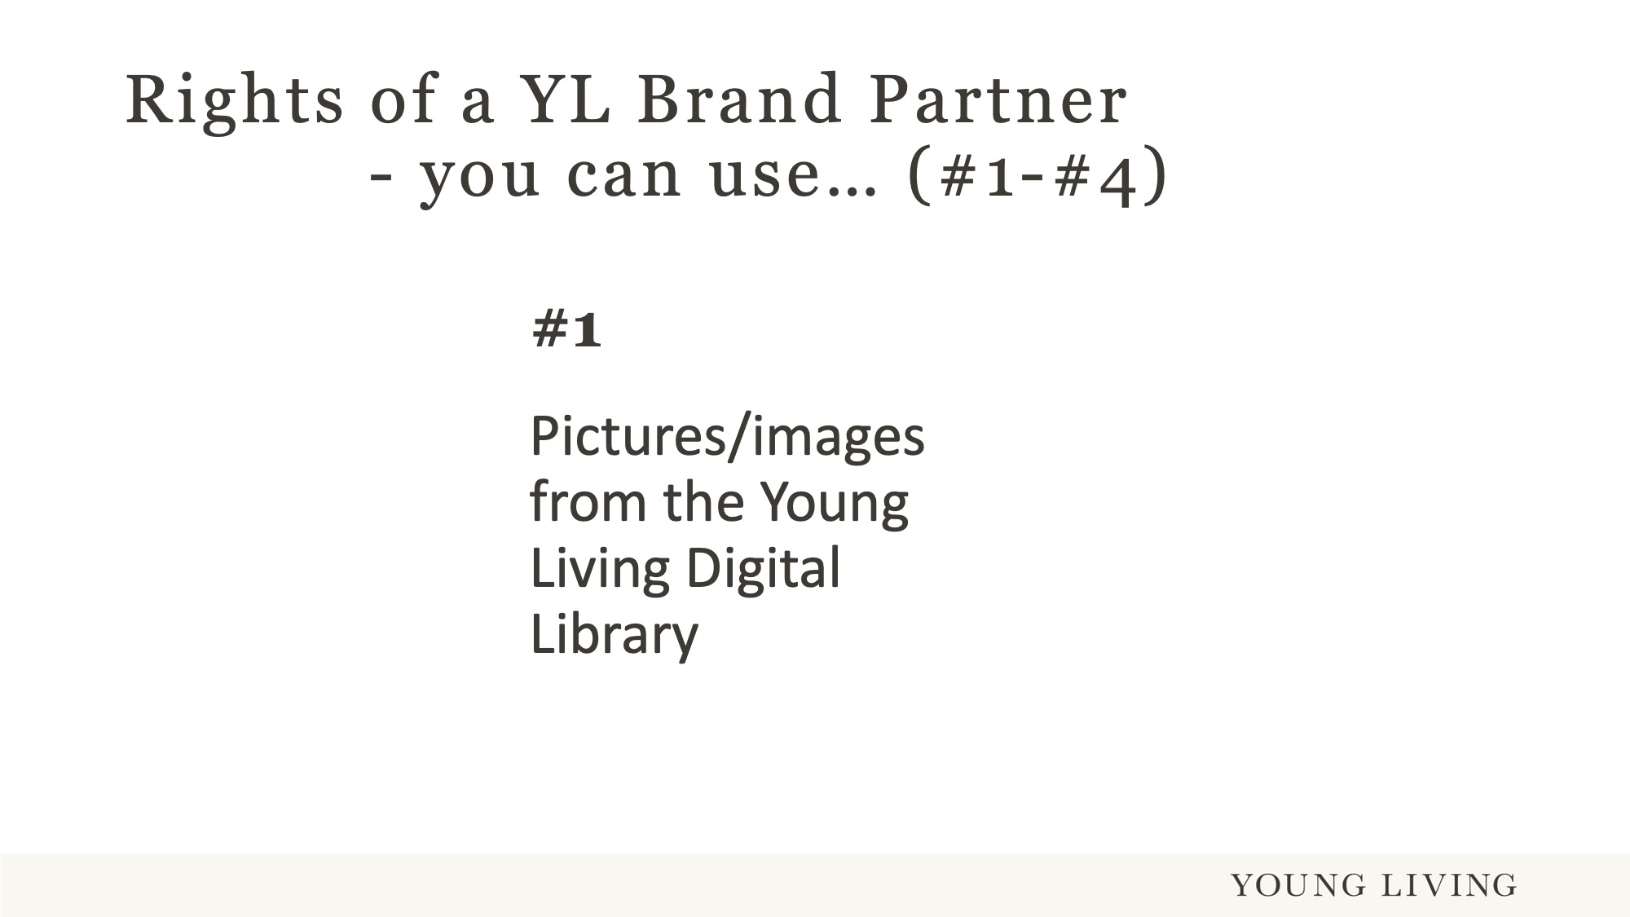
Notes:
As a YL Brand Partner, you have certain rights to use the YL Trademark for your work you do for YL. This is outlined in the YL Policies.
You can use: Pictures/images from the Young Living Digital Library

Slide 9
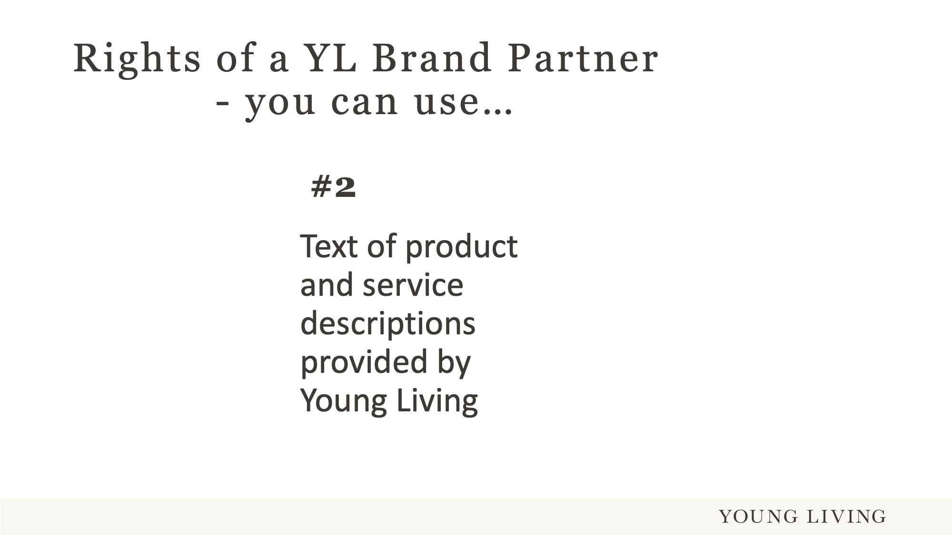
Notes:
You can use: Text of product and service descriptions provided by Young Living

Slide 10
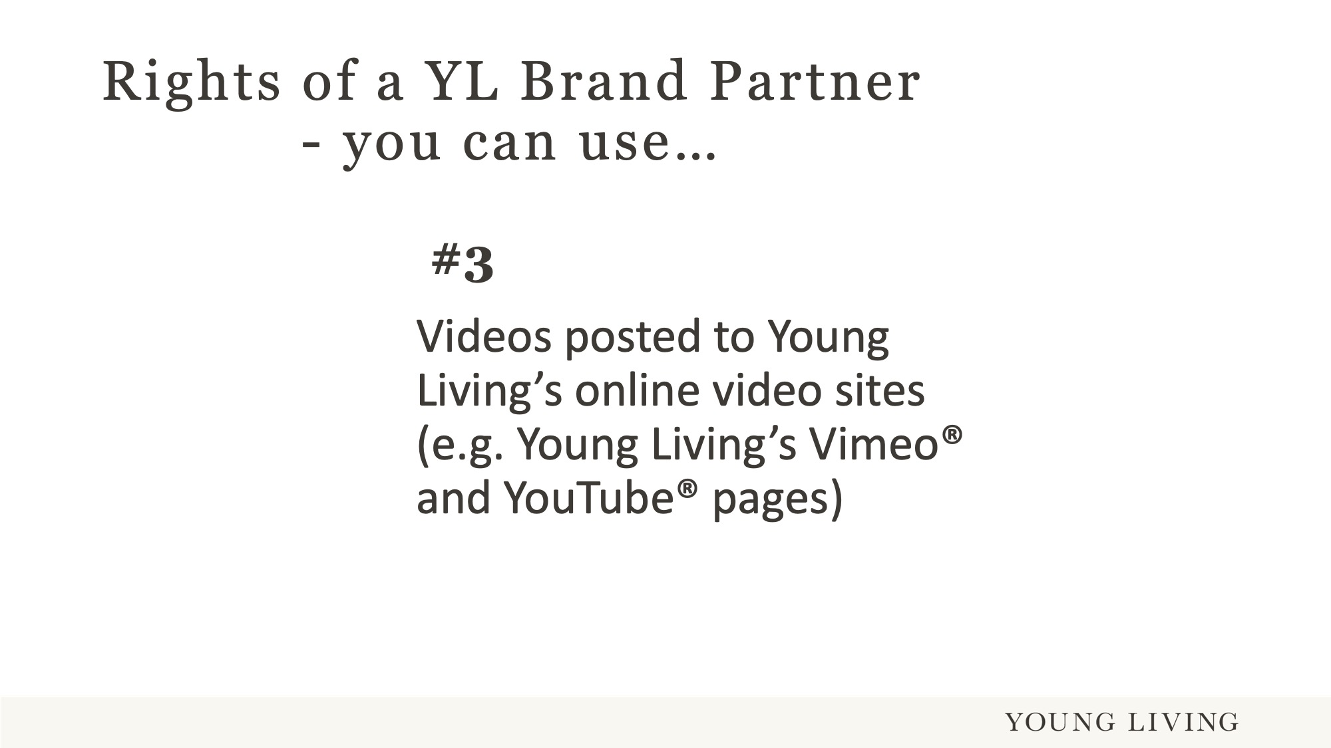
Notes:
You can use: Videos posted to Young Living’s online video sites (e.g. Young Living’s Vimeo® and YouTube® pages)

Slide 11
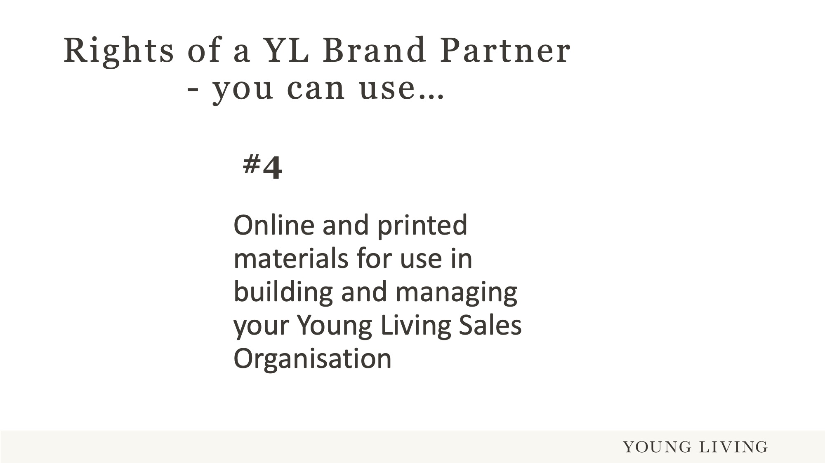
Notes:
You can use: Online and printed materials for use in building and managing your Young Living Sales Organisation

Slide 12
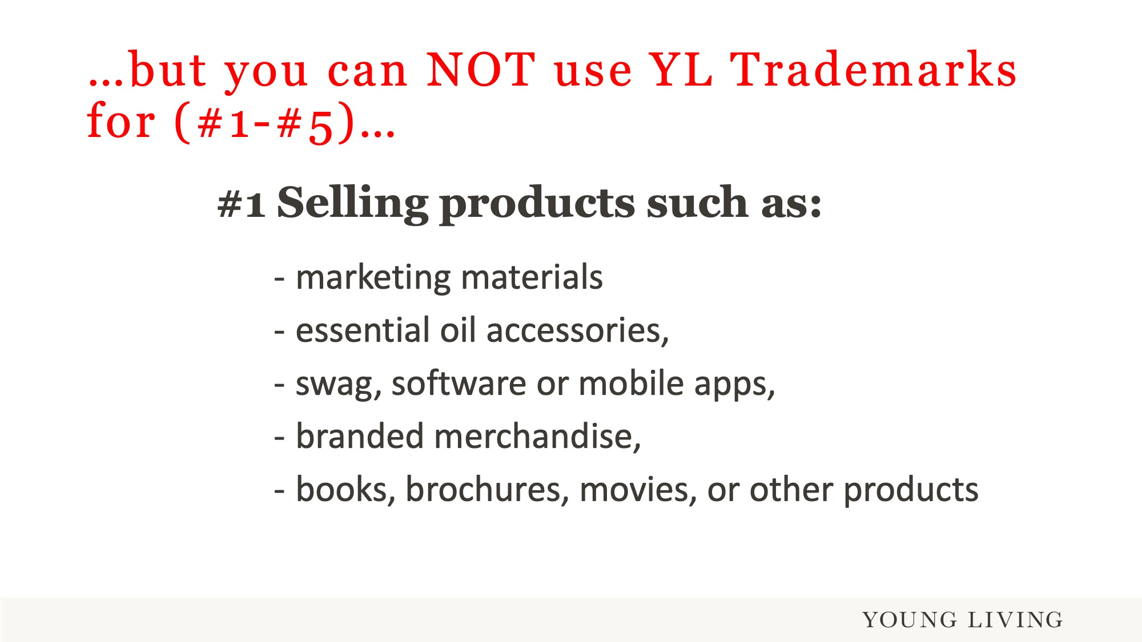
Notes:
You CANNOT use YL Trademarks when selling products mentioned in this slide.

Slide 13
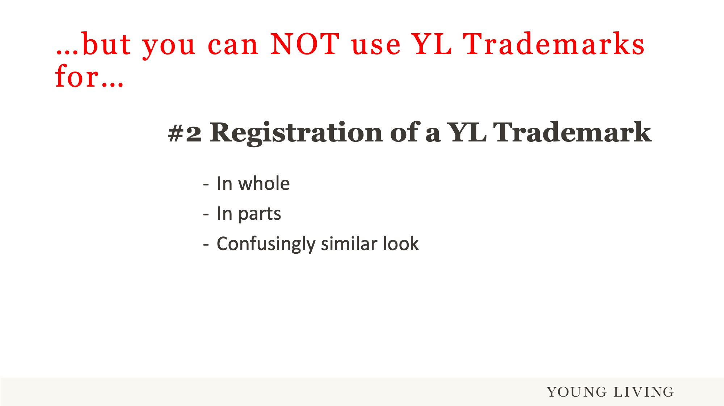

Slide 14
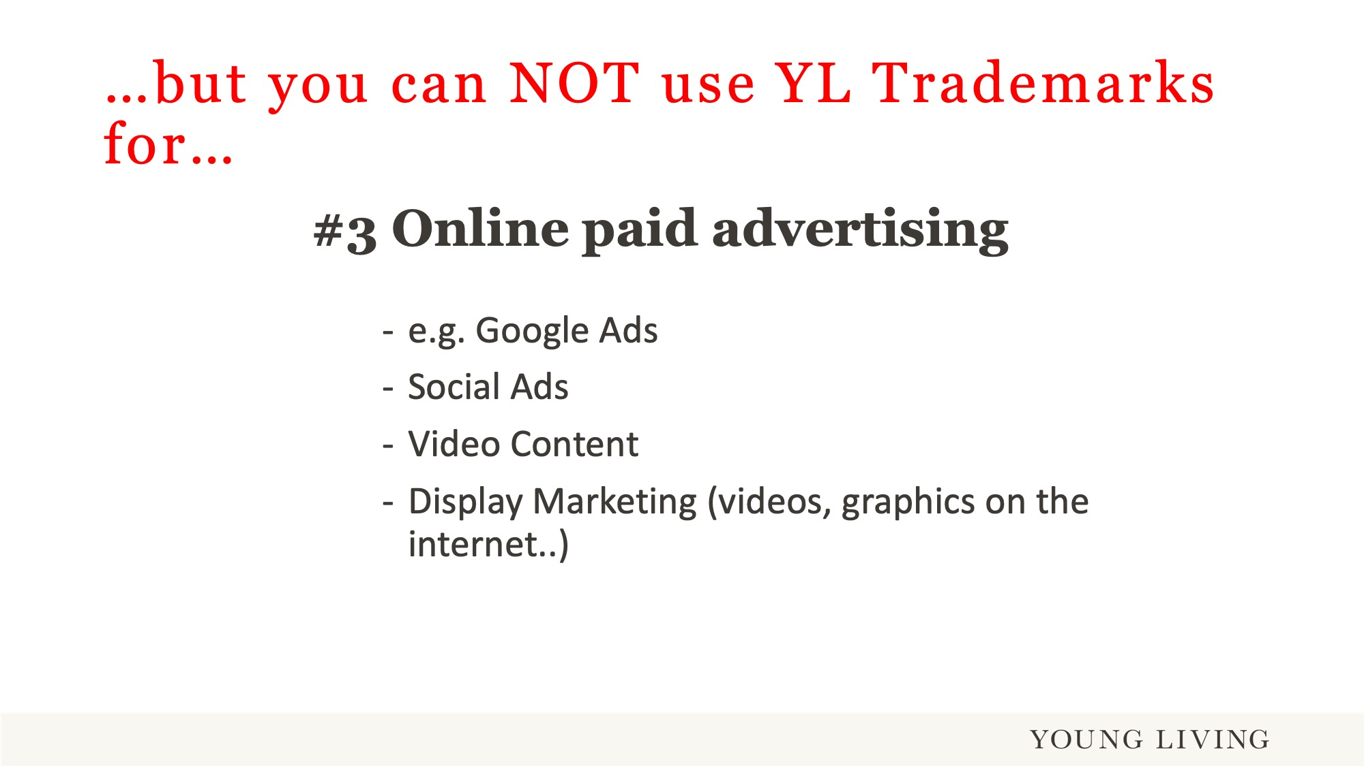

Slide 15
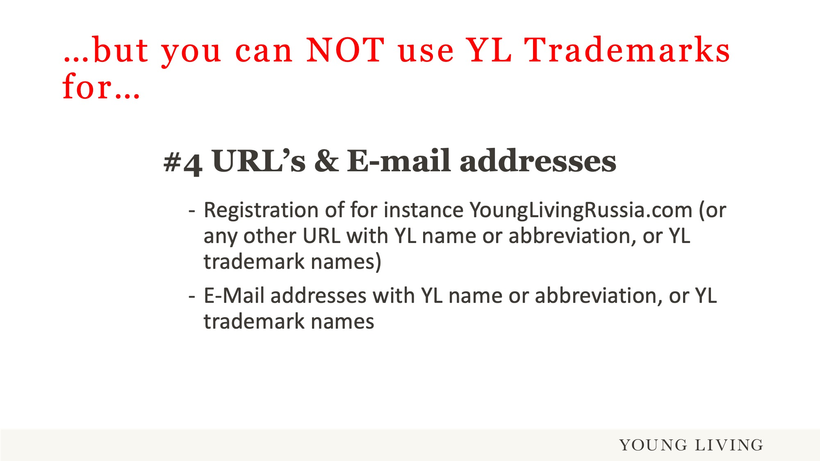

Slide 16
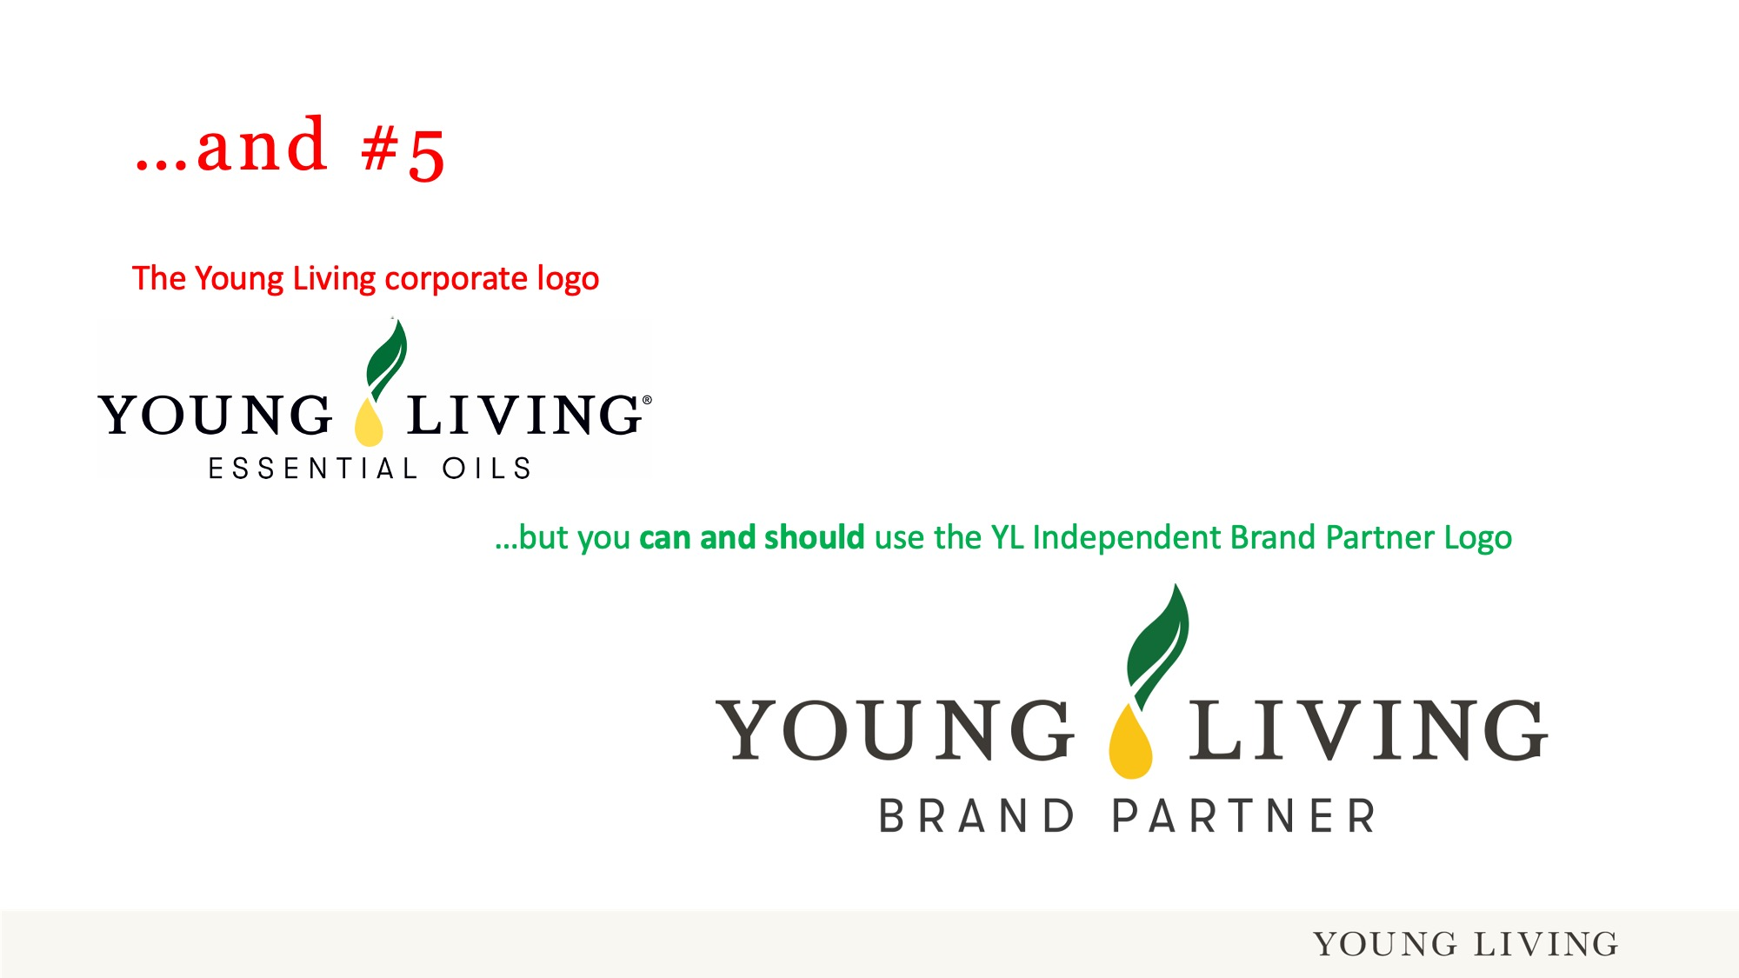

Slide 17


Slide 18
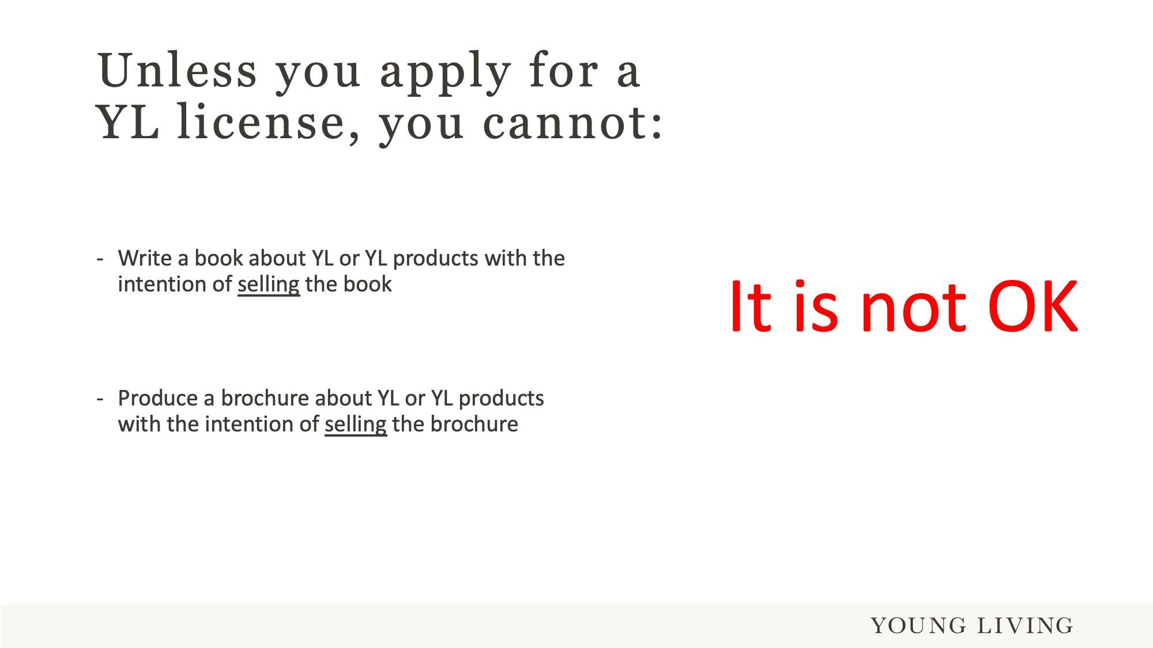

Slide 19
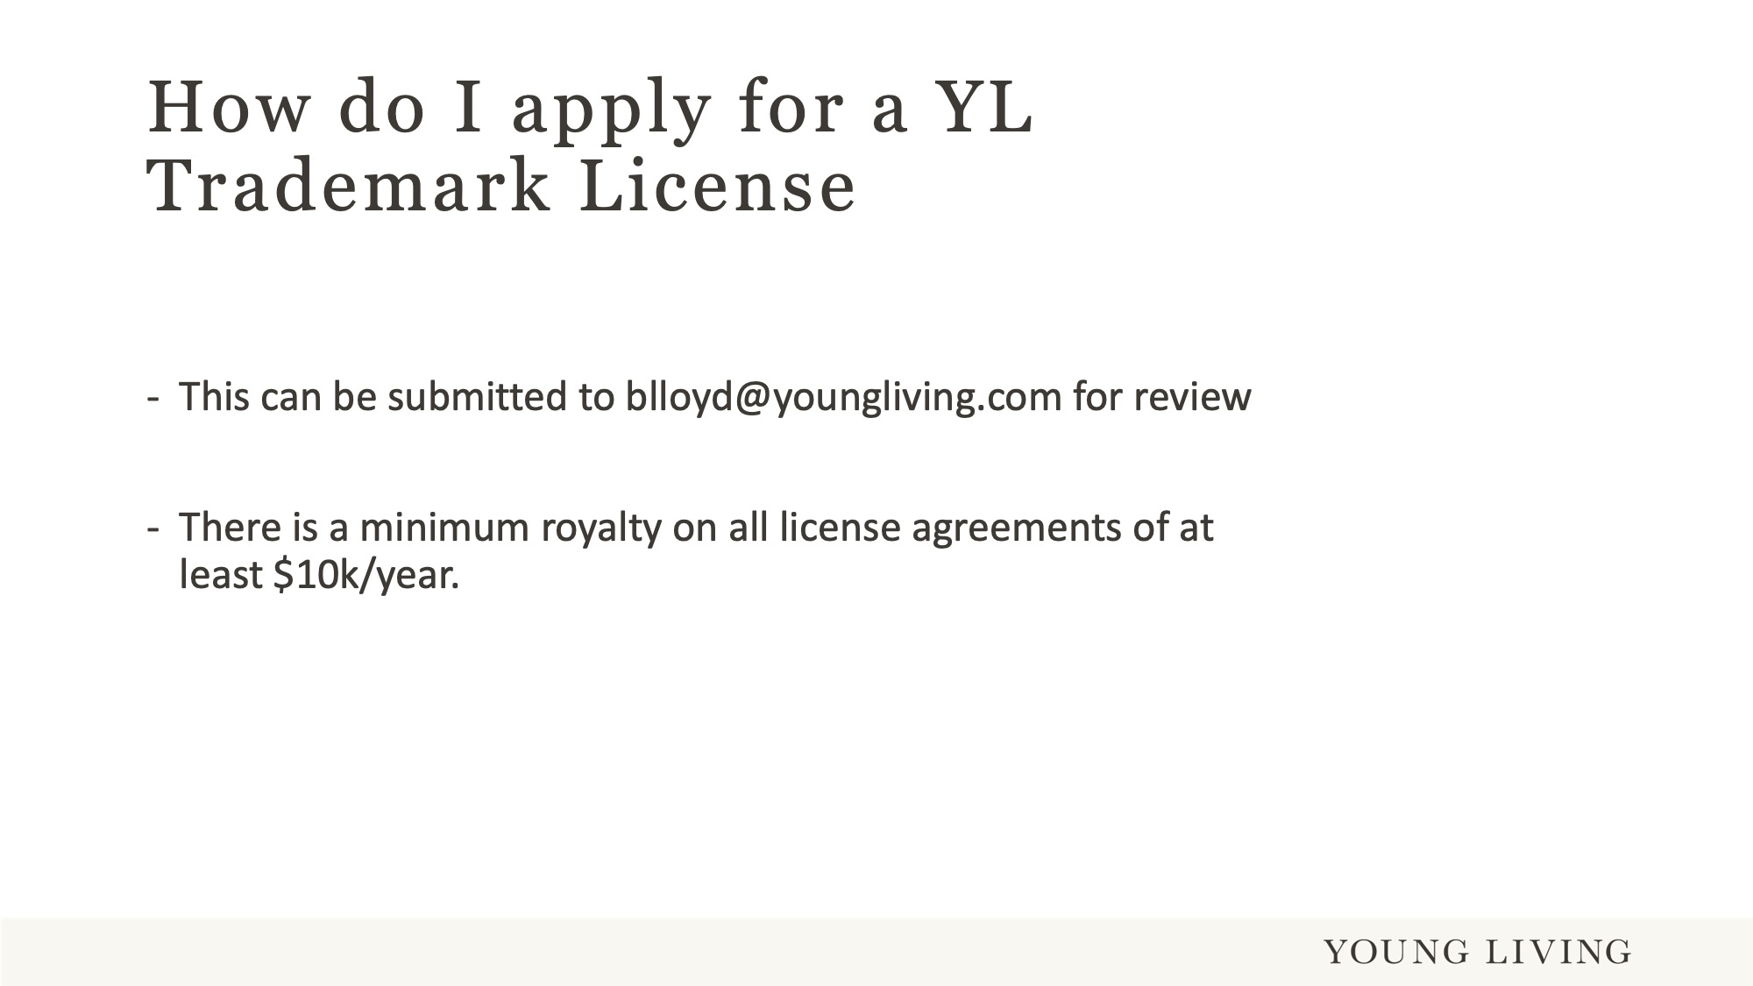

Slide 20
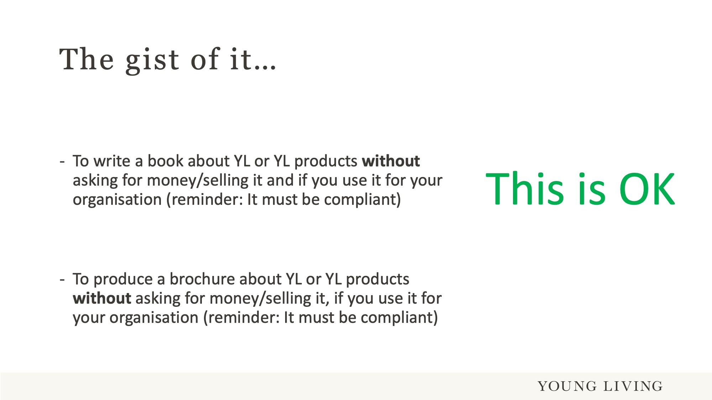

Slide 21
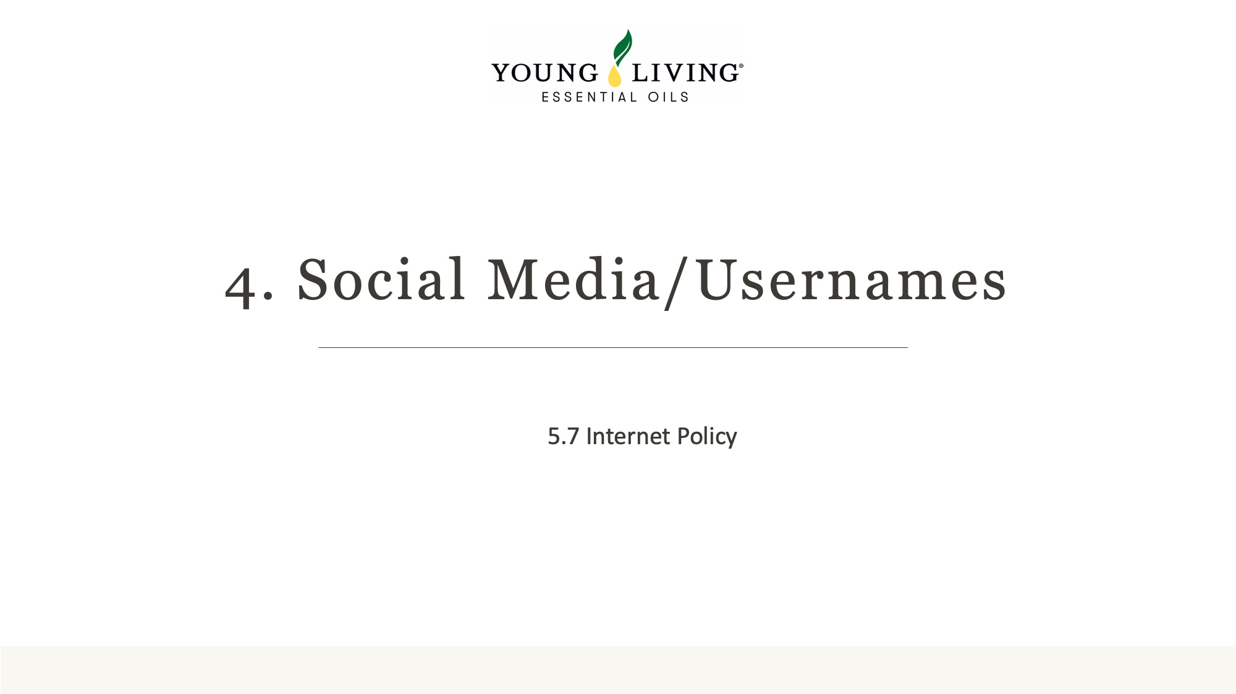

Slide 22
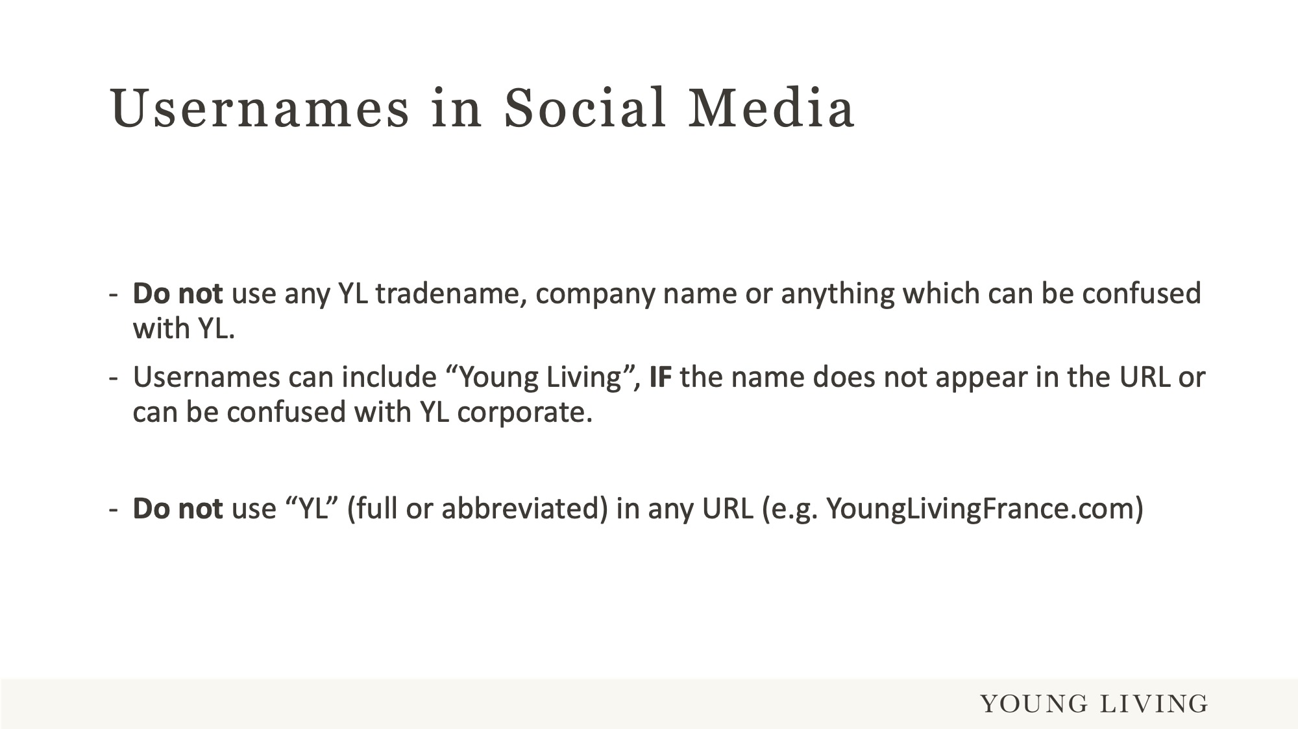
Notes:
For a person who has no idea who YL is, and what YL stands for, it must be easy to determine if this person is looking at a corporate YL social media page or a YL Brand Partner social media page.
It is therefore advisable to identify yourself as a YL Brand Partner with your YL BP ID.

Slide 23
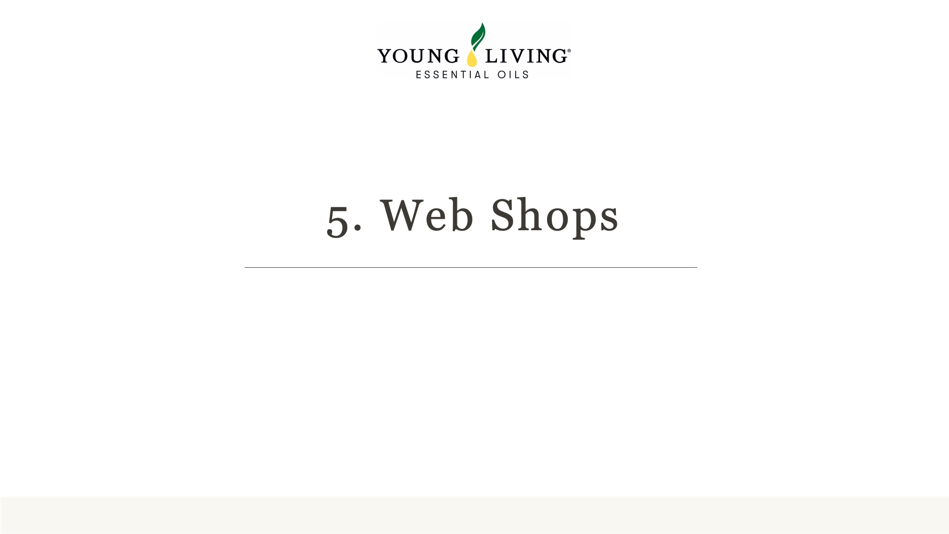

Slide 24
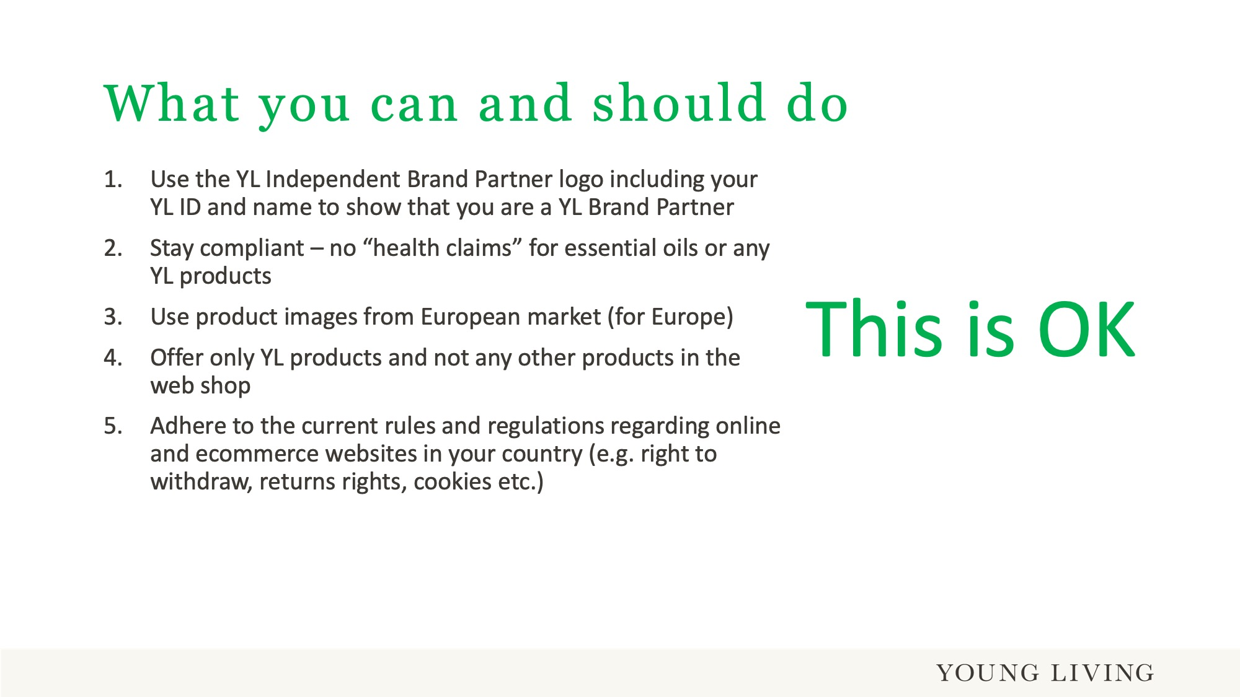

Slide 25
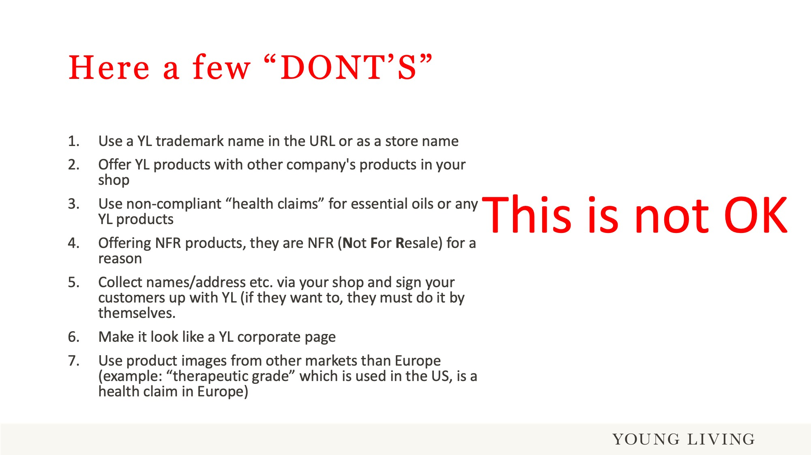

Slide 26
