Slide 1
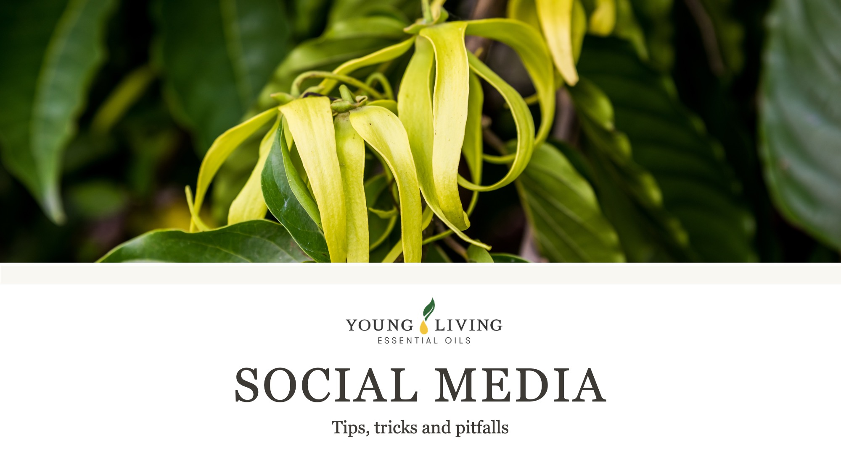
Notes:
This presentation is ideal for every BP who uses Social Media.

Slide 2
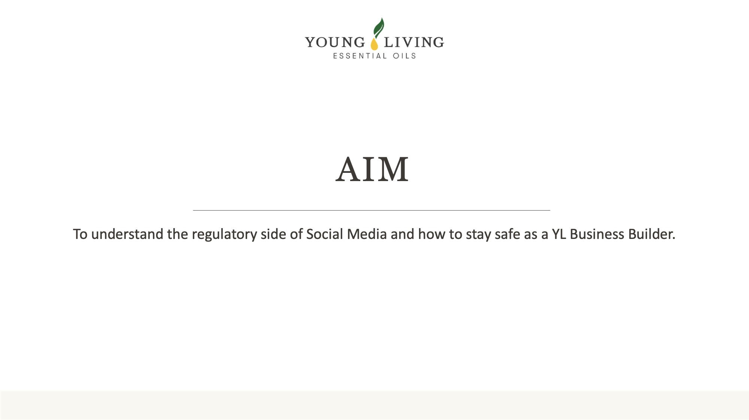

Slide 3
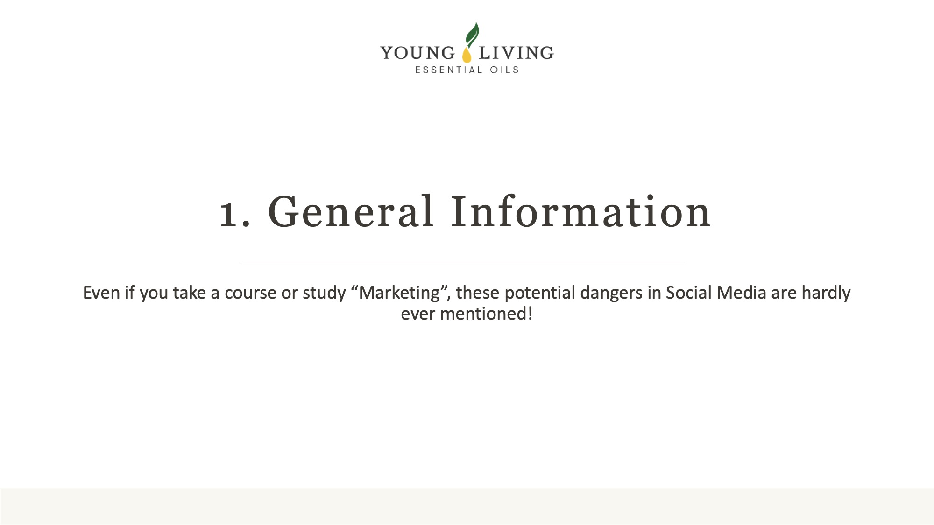
Notes:
Even if you take a course or study “Marketing”, these potential dangers in Social Media are hardly ever mentioned! It is however very important to know about these potential dangers. Once you are aware of those, the knowledge is very easy to apply.

Slide 4
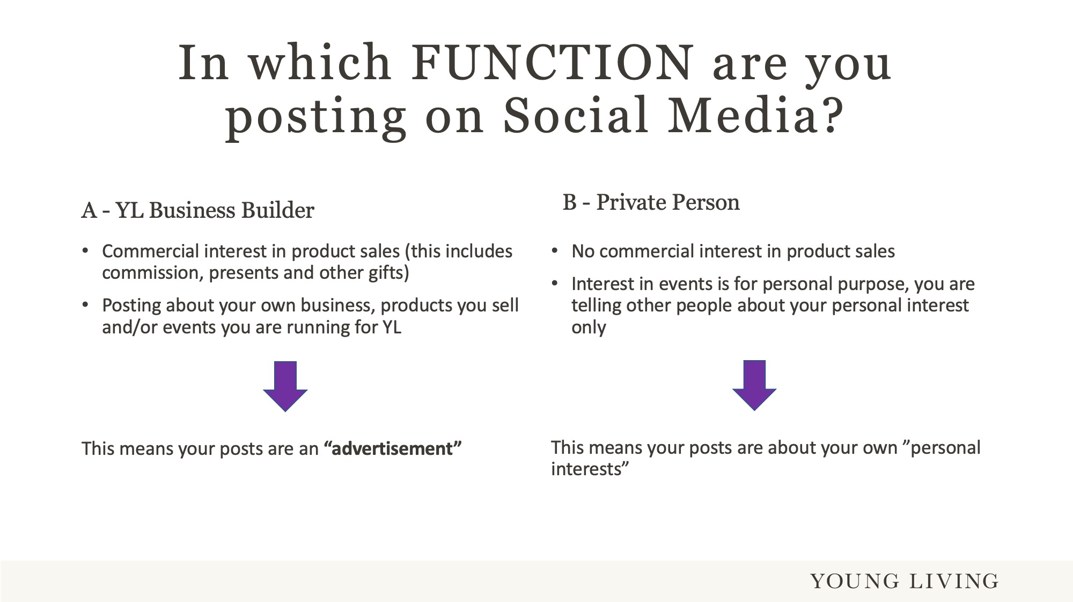
Notes:
Usually there is a difference if you use Social Media as a business person (Brand Partner), or a private person, who posts about his/her own personal interests.
Business Person/Brand Partner
You receive either a gift, a payment, or both from a company to make posts on social media. This means you “advertise” about this product or the company. It also automatically puts you in the same situation as an “influencer”.
What is an influencer?
An influencer is someone who promotes brands to their social media followers on channels such as Instagram, Facebook and TikTok, or other platforms like Twitter and LinkedIn. Influencers usually get compensation for their services, which can be through gifts or money. However, recent court rulings show that even if influencers do not get paid and post a “private” opinion, courts decided that their posts are still business related.
YL Brand Partner:
As a YL BP you receive commission payments for your services. Therefore you have a commercial interest in the sale of YL products and your posts are classed by the regulator as an “advertisement”.
Private Person/Customer:
There is no commercial interest, you simply want to share your love or dislike for a product and how good or bad it is.
Advertisements:
Advertisements must be marked and must be easily recognisable as an advertisement. How this has to happen will be explained in the next slides.

Slide 5
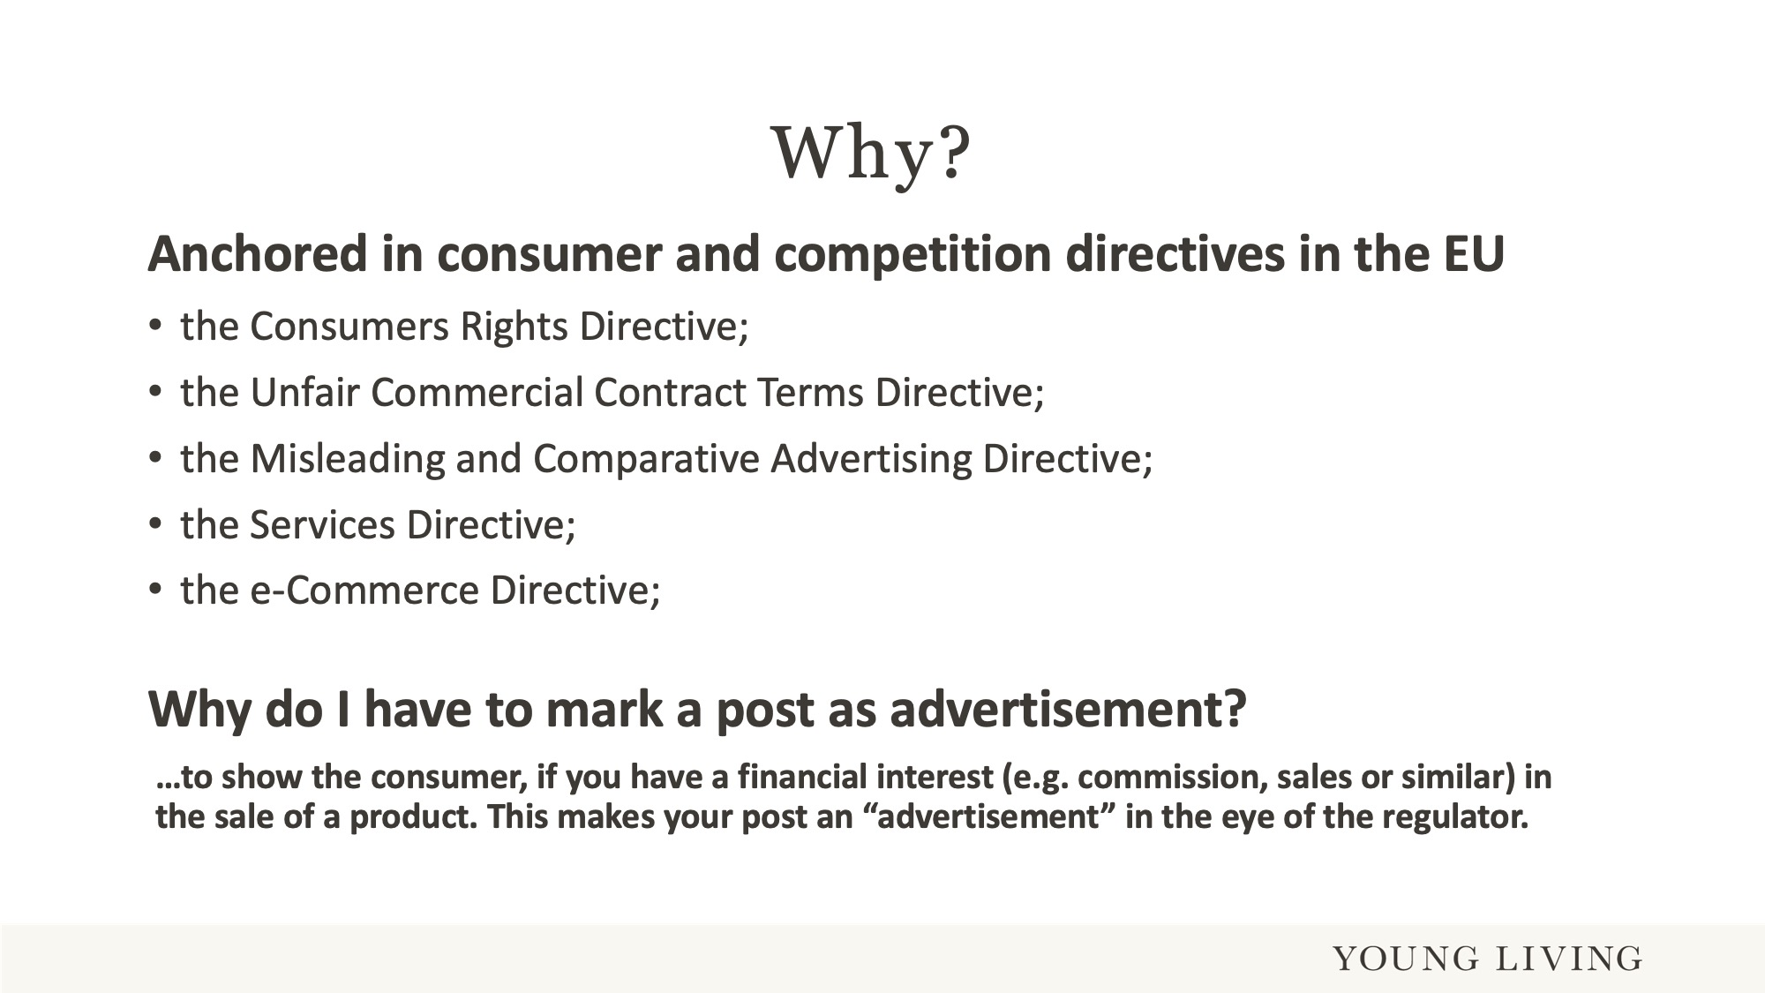
Notes:
Let us answer the “why” first. Why do you have to mark a post as an advertisement? There is not only one regulation which plays into this, but several.
As a business person, Brand Partner or influencer you must show the consumer (reader of your post) that you have a financial interest in the sale of a product.
If you use social media for business purposes, please always check the terms and conditions of that platform, if you have to fulfil certain terms.

Slide 6
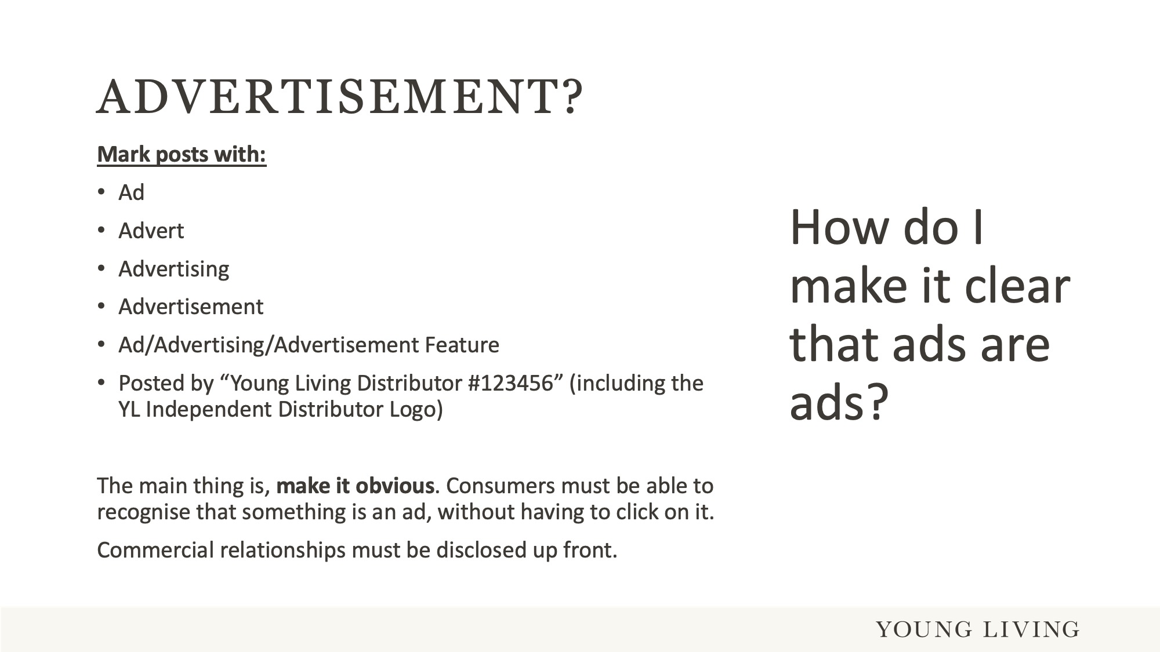
Notes:
All social media posts which are posted as Brand Partner must be marked as advertisement. This can be done with any of the above by #Ad or #advertisement or similar.
Your contact information on Social Media must include your name (YL account name), your YL ID and the Young Living Brand Partner logo, so you can be identified as a YL Brand Partner.
Important question – If you add your YL profile (name, YL ID and BP logo) to your contact information, why should you additionally mark every post as an advertisement?
Answer: Posts can be pulled or reposted on someone else’s social media. This one post then appears as a single unit somewhere else, where no one sees your “contact information” or that it is an advertisement.

Slide 7
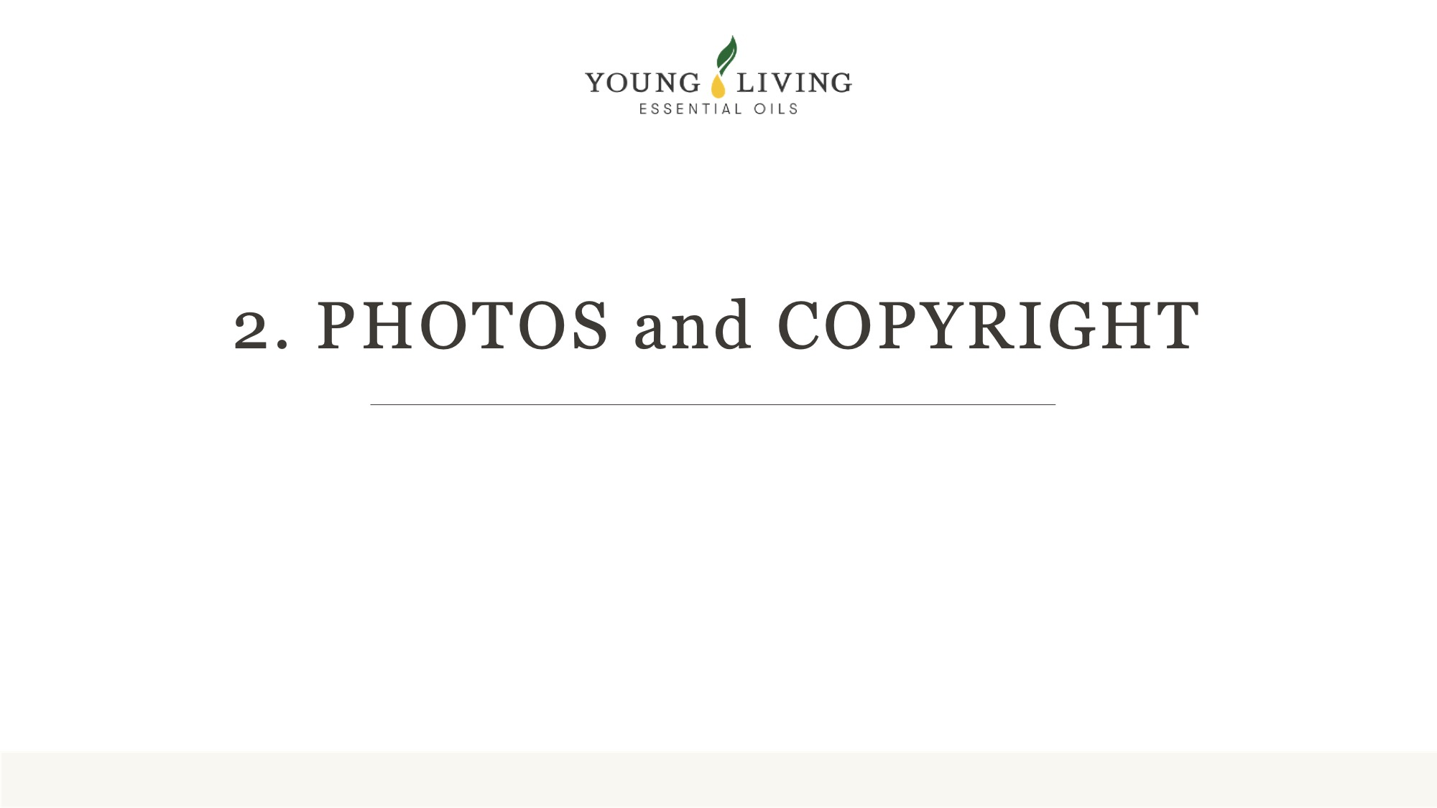

Slide 8
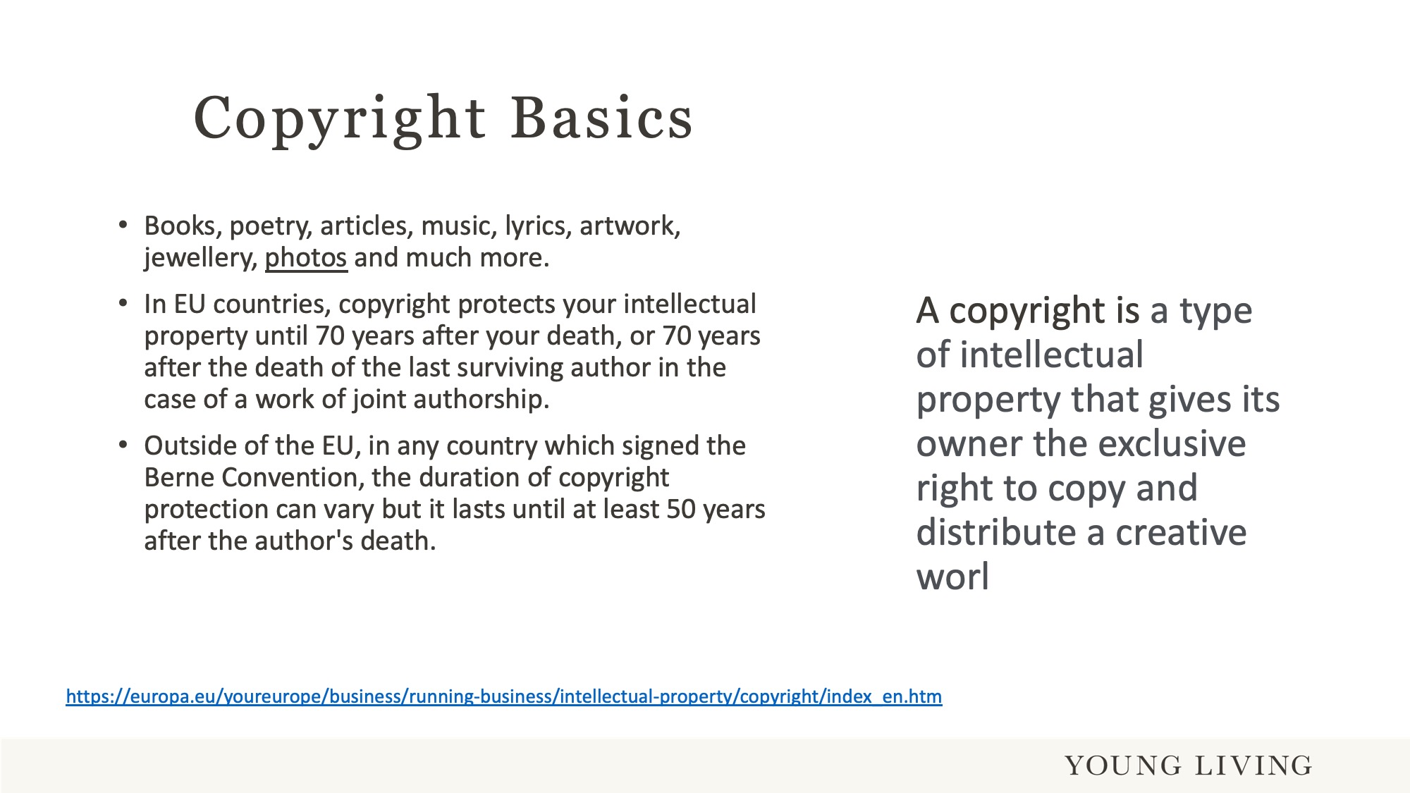
Notes:
A copyright is a type of intellectual property that gives its owner the exclusive right to copy and distribute a creative work, usually for a limited time. The creative work may be in a literary, artistic, educational, or musical form.
Many things can be copyrighted like books, photos, lyrics, music and much more.
Copyright in the EU is from the point of creation until 70 years after the authors death.
Outside the EU it is from the point of creation until 50 years after the authors death.
If you want to read more about intellectual property and copyright, please feel free to peruse the information provided with this link.

Slide 9
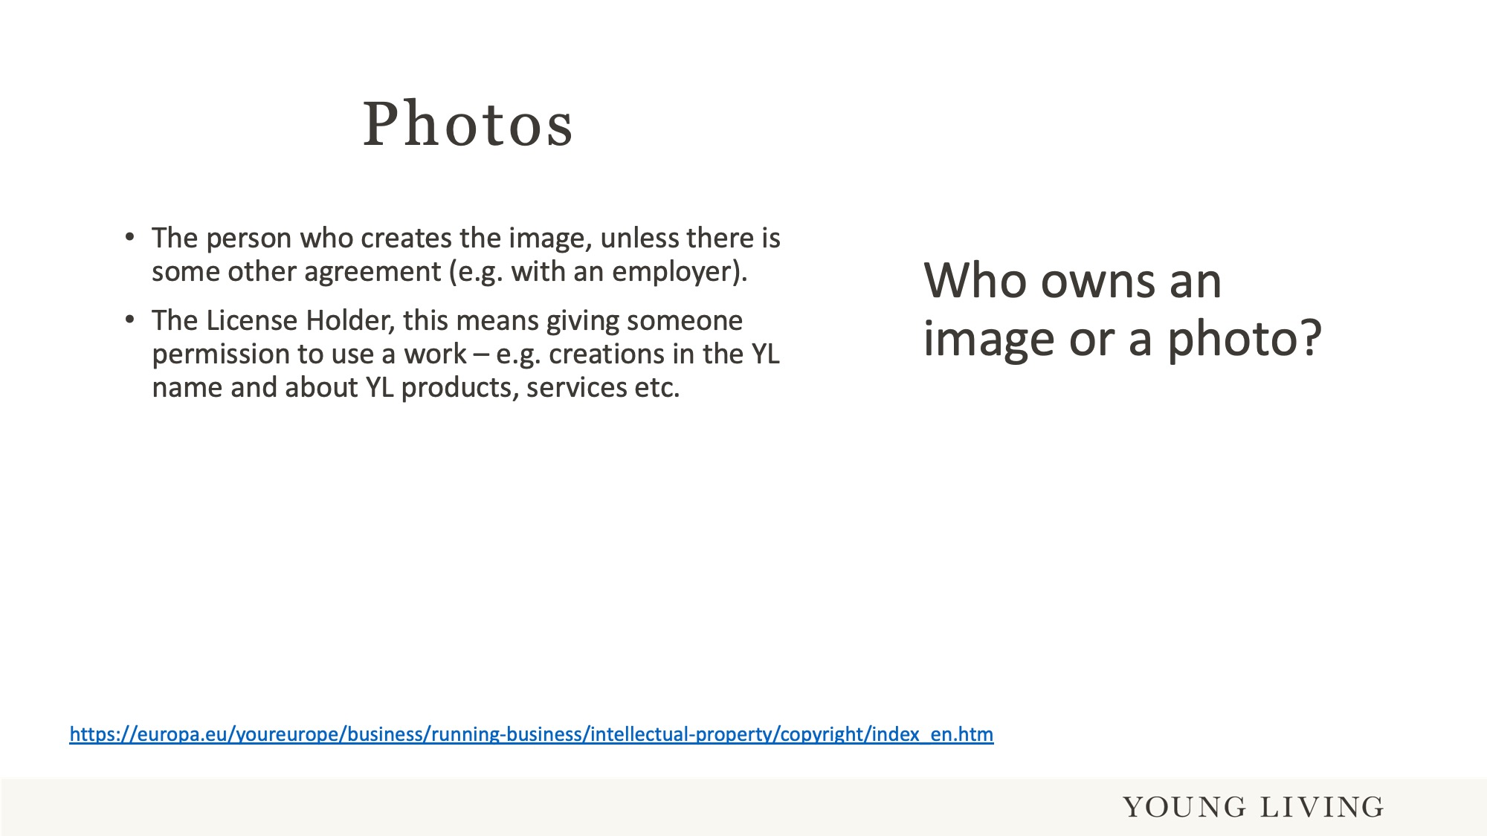
Notes:
Generally speaking it is very simple. The person who creates a photo is the owner of it. The legal term for this ownership is “intellectual property”.
I an employee takes a photo in behalf of a company, then the photo/“intellectual property” is owned by the company.

Slide 10
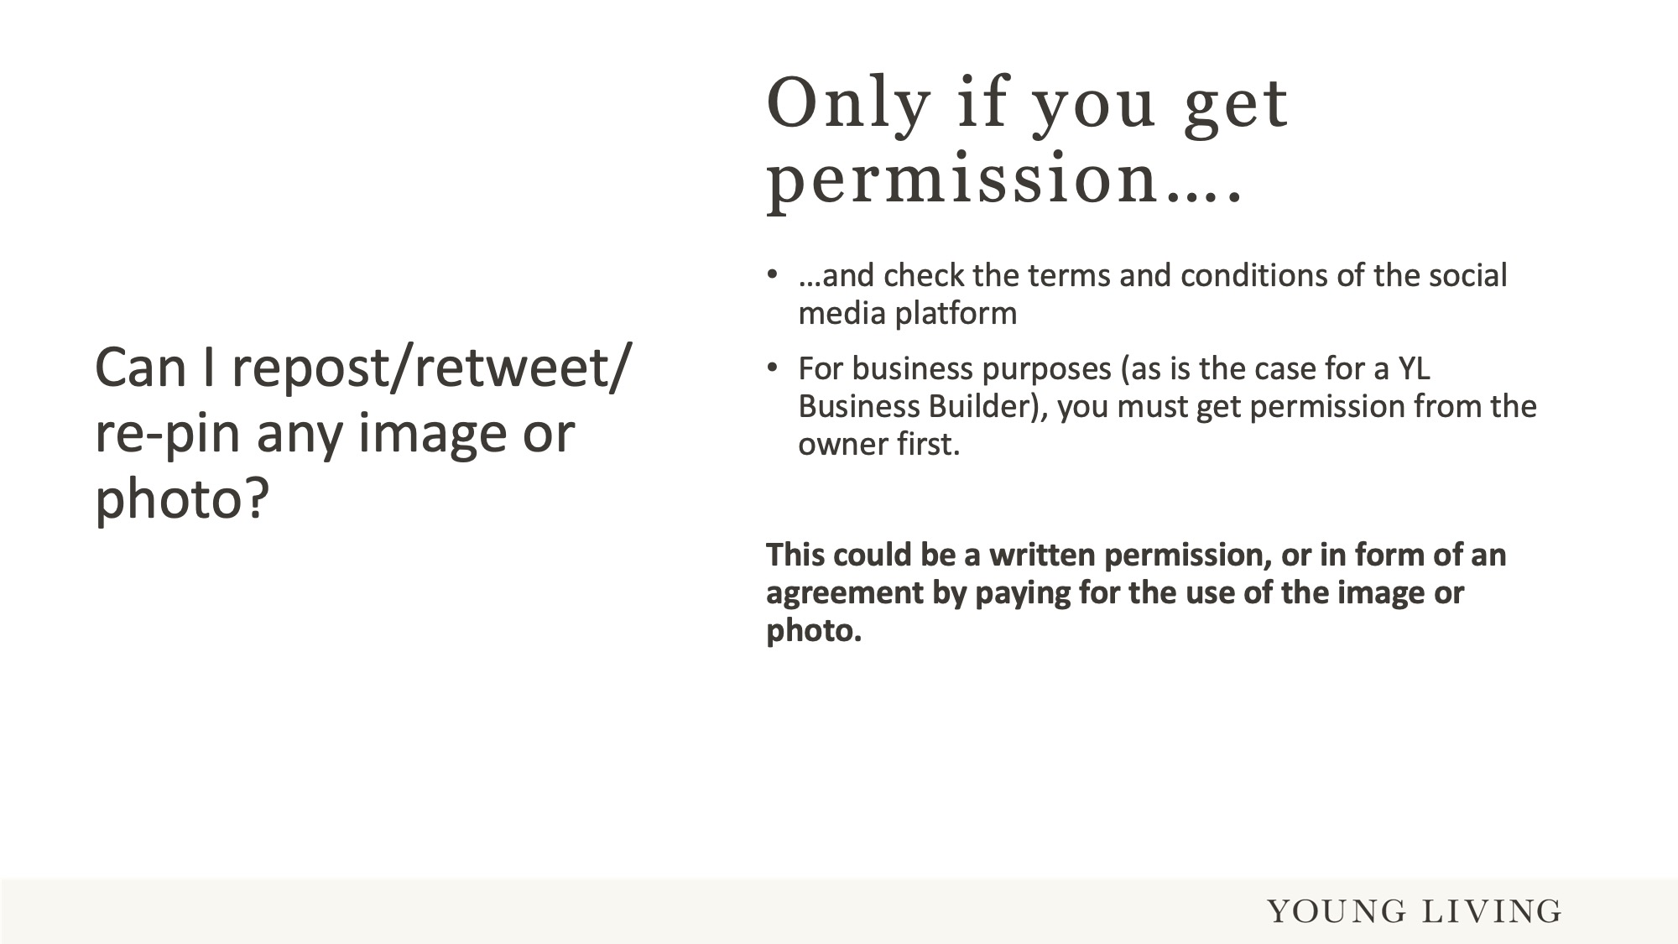
Notes:
Always get permission of the owner before you repost, re-pin or retweet an image or a photo.
This can be in the form of a written permission, or a payment agreement for the right to use an image of photo for business purposes. You posting as a Brand Partner would be such a business purpose.
If you use a photo from a platform (e.g. Pinterest), always check the terms and conditions of that platform. As example, Pinterest demands the confirmation during the sign up, that the person how pins a photo has the permission of the owner. However, this is no guarantee that the owner’s permission has been given. Permission is not checked or verified by Pinterest.
Quote from Pinterest
“Pinterest allows you to post content, including photos, comments, links, and other materials. Anything that you post or otherwise make available on Pinterest is referred to as "User Content." You retain all rights in, and are solely responsible for the User Content you post to Pinterest.”

Slide 11
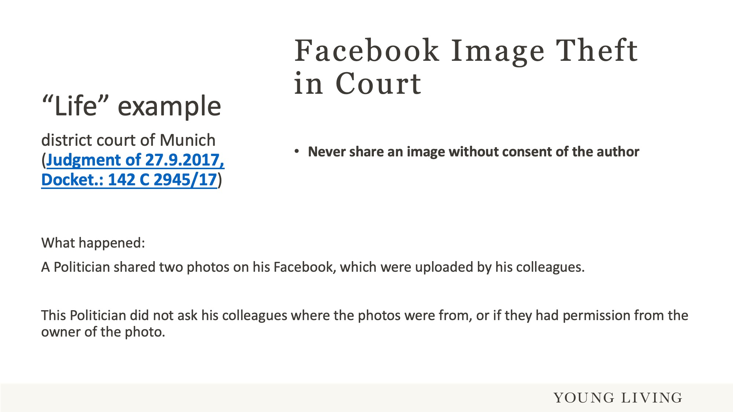
Notes:
What we can learn from this court ruling is, to never share an image without the consent from the author/owner of the intellectual property.

Slide 12
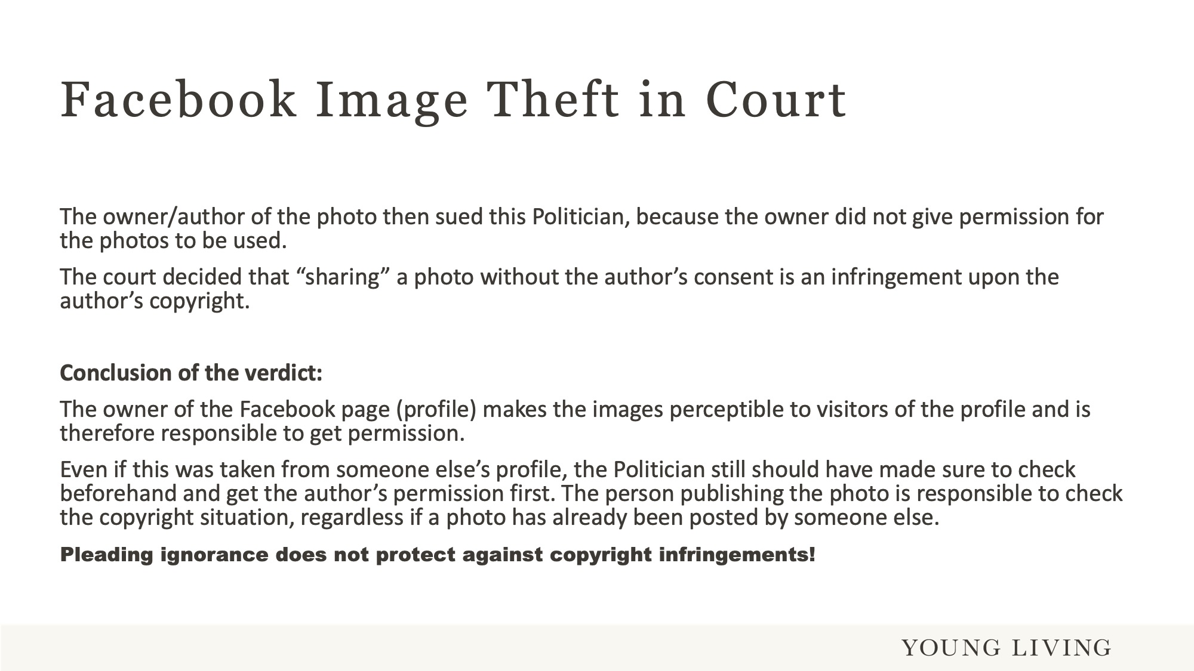
Notes:
For business purposes, if you do not know the owner, have no written permission to use an image or photo, it can be broken down to a few words “don’t post it”.
As a YL Brand Partner you are permitted to use photos, images and videos produced by YL.
Be especially careful when you have images or photos from films or famous people. Firstly, these images/photos are usually owned by one of the big filming companies and/or by that celebrity. The intellectual property owned by one of these companies/person’s are usually safeguarded by lawyers, who will not hesitate to take legal action.

Slide 13
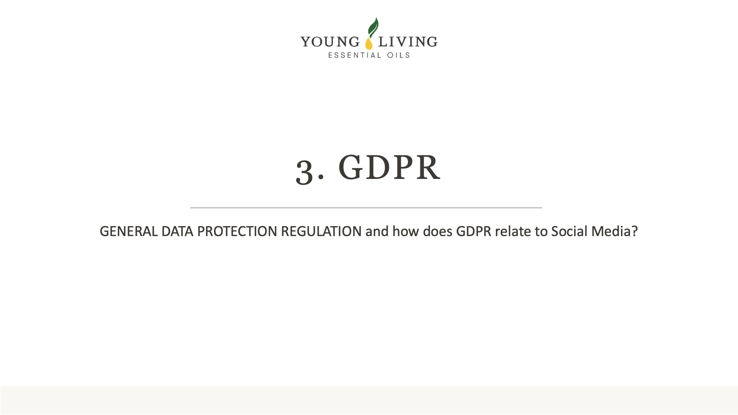

Slide 14
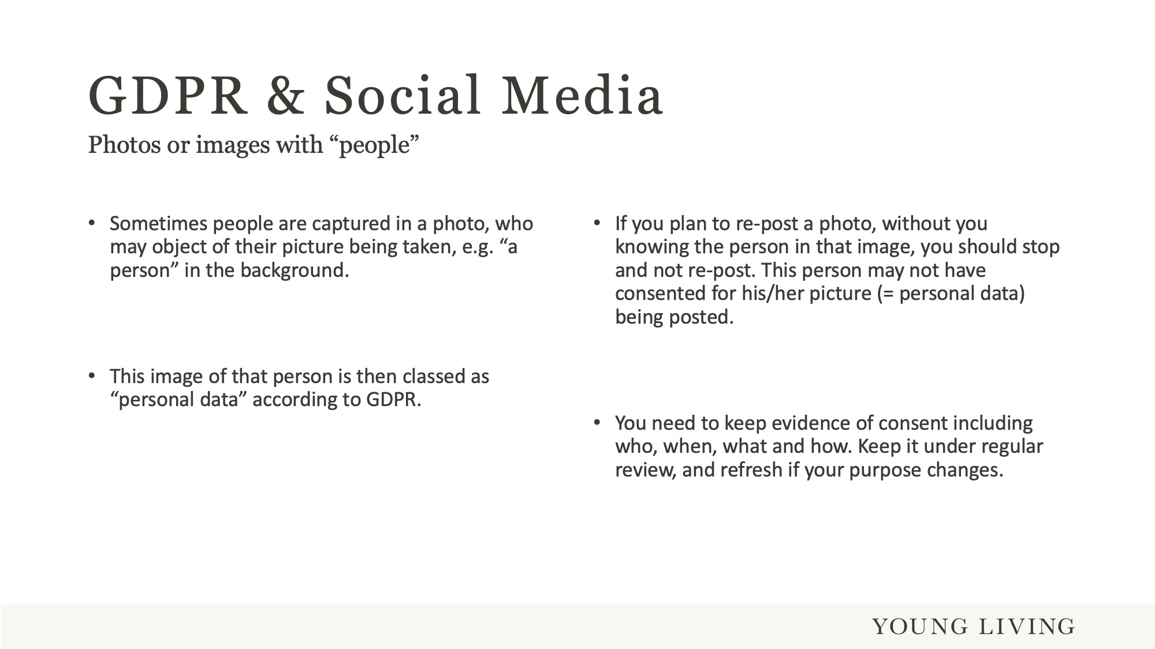
Notes:
Everyone gets a bit nervous when they hear “General Data Protection”.
If you take a photo with people in it, and you intend to use it for business purposes (e.g. your YL Facebook), then you have to be mindful of a few facts. These are:
Always get consent of that person or the people in your picture. Consent must be in written form and will have to be renewed. The regulator does not specify a renewal time, but it makes sense to ask once a year.
If getting consent is not possible, then make the people in the picture unrecognisable (e.g. photo shop). Pay special attention to children in a picture and “blur them out”.

Slide 15
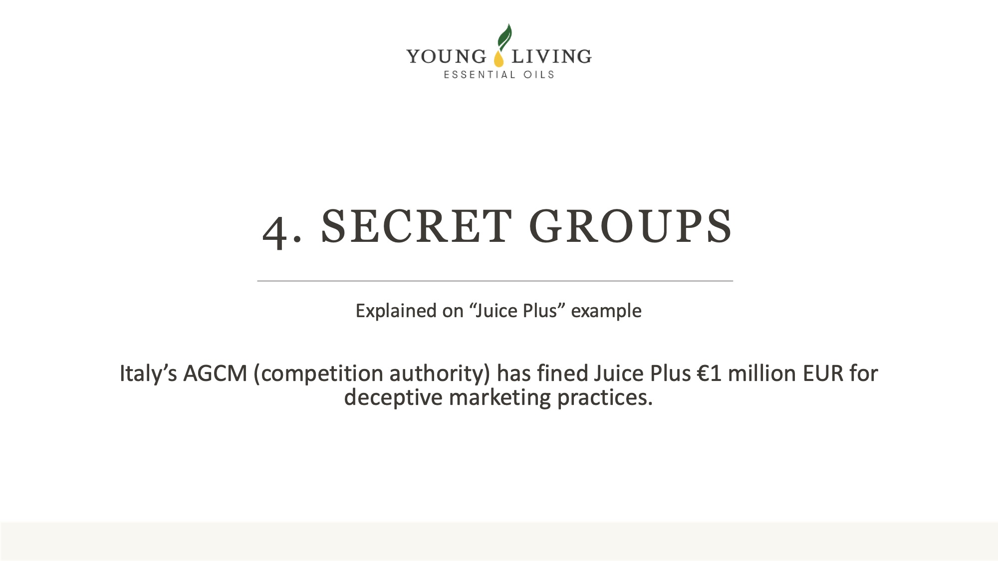
Notes:
Secret social media group are not “secret”. You will hear now what happened to “Juice Plus”, a reputable and fellow MLM company.

Slide 16
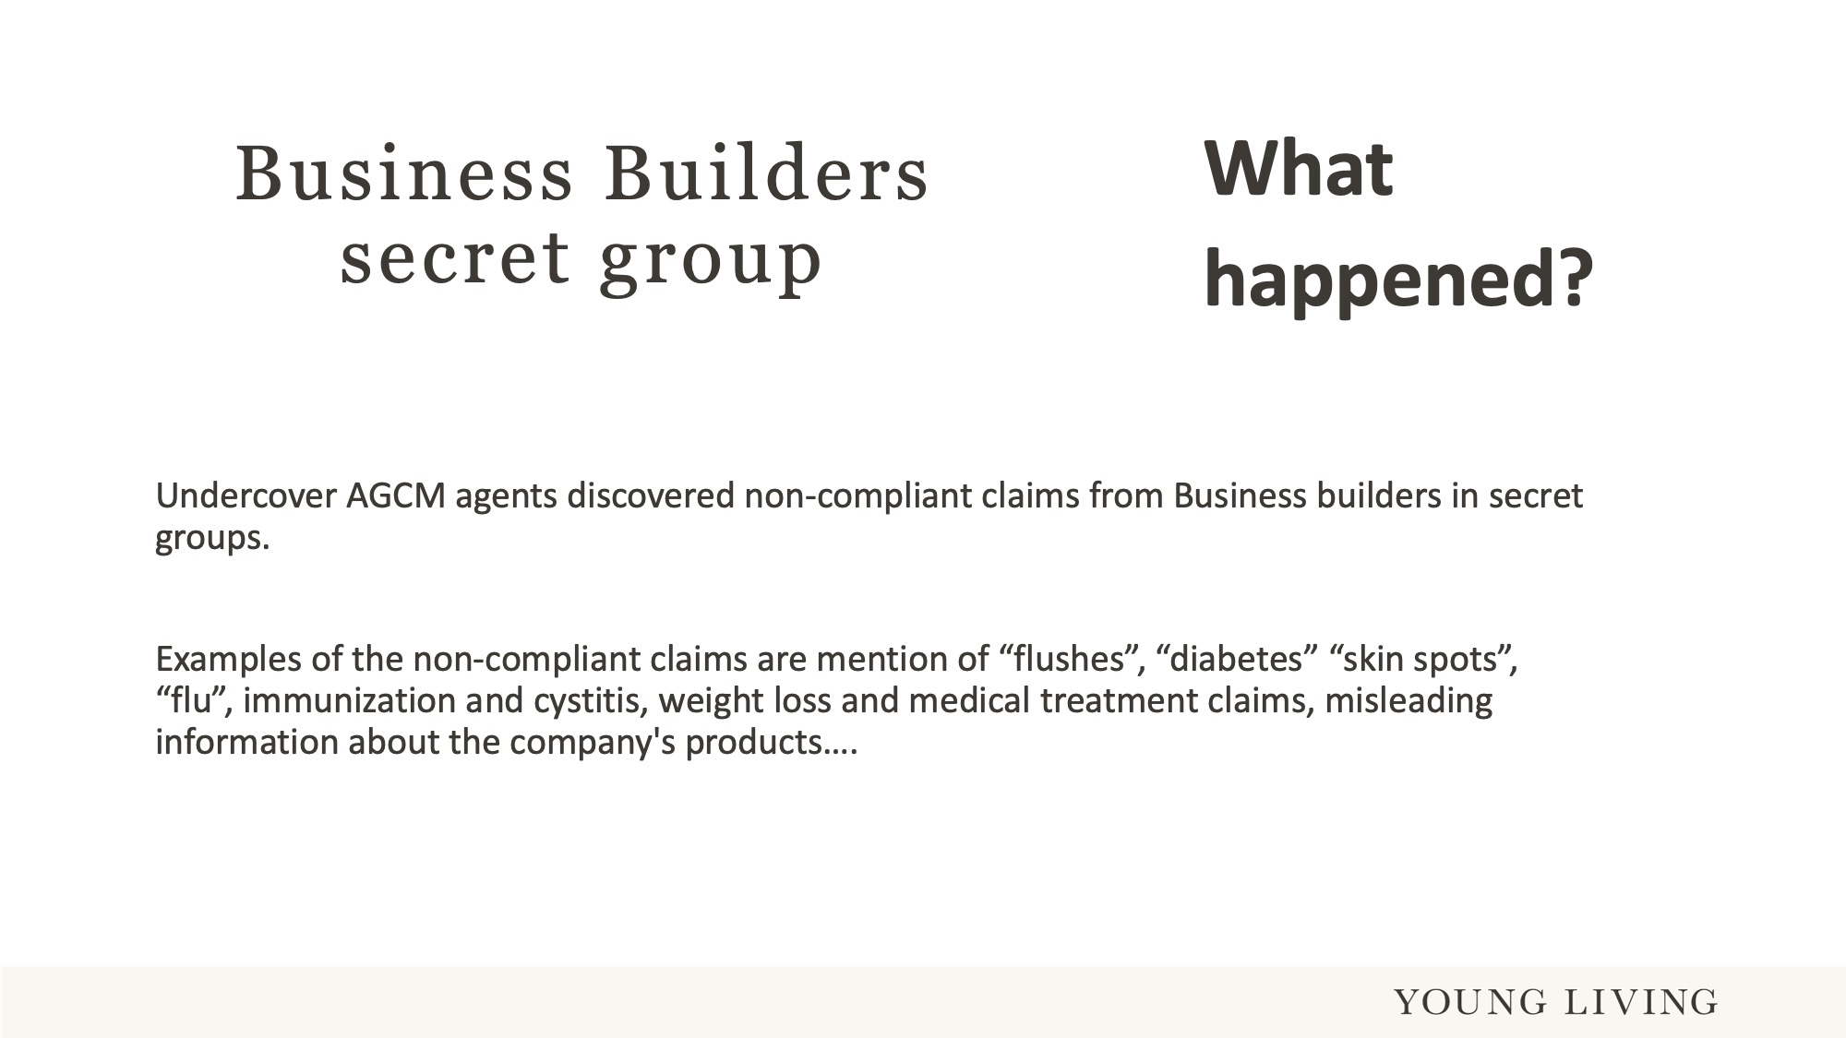
Notes:
Undercover agents were dispatched to get into secret social media groups of Brand Partners of Juice Plus.
These undercover agents discovered non-compliant claims from Business builders/Brand Partners in secret groups.
They found various healing claims, where Business builders/Brand Partners thought they could say “more” about the products in their closed groups.

Slide 17
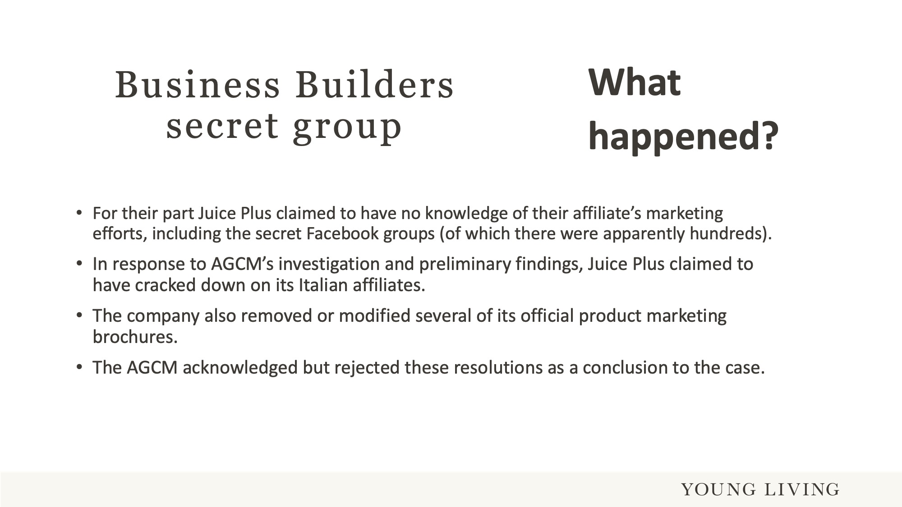
Notes:
The findings were reported to Juice Plus, how had no knowledge of this and the content in closed social media groups.
Juice Plus then contacted the Business builders/Brand Partners and helped them amend the posts and also amended some of their literature and brochures.

Slide 18
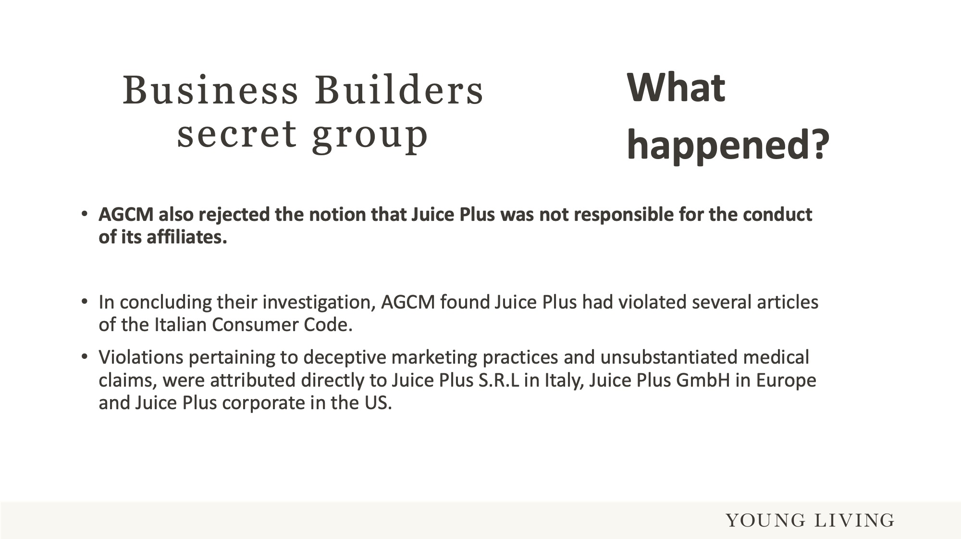
Notes:
However, the regulator AGCM was not satisfied with that resolution and made Juice Plus responsible for the Business builders/Brand Partners posts in closed groups.
The regulator not only made Juice Plus Italy responsible, but they also linked this to Juice Plus GmbH in Europe and Juice Plus corporate in the US. The result was a fine of 1 million Euros.

Slide 19
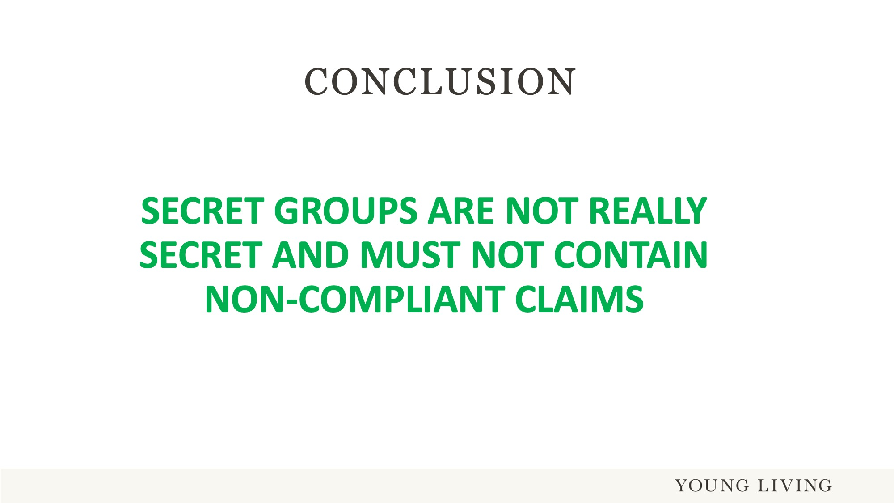
Notes:
Tip:
If you have old posts, delete them and use the opportunity to visit a topic again with compliant content.
Regulations change now and again. It is possible that an old post was OK years ago due to a different regulation. However, if that regulation changed, then the auditing regulator will not look at that date. They only check if available posts match the current regulation. One more reason to remove old posts.
Keep closed groups “clean”, don’t post any non-compliant claims.

Slide 20
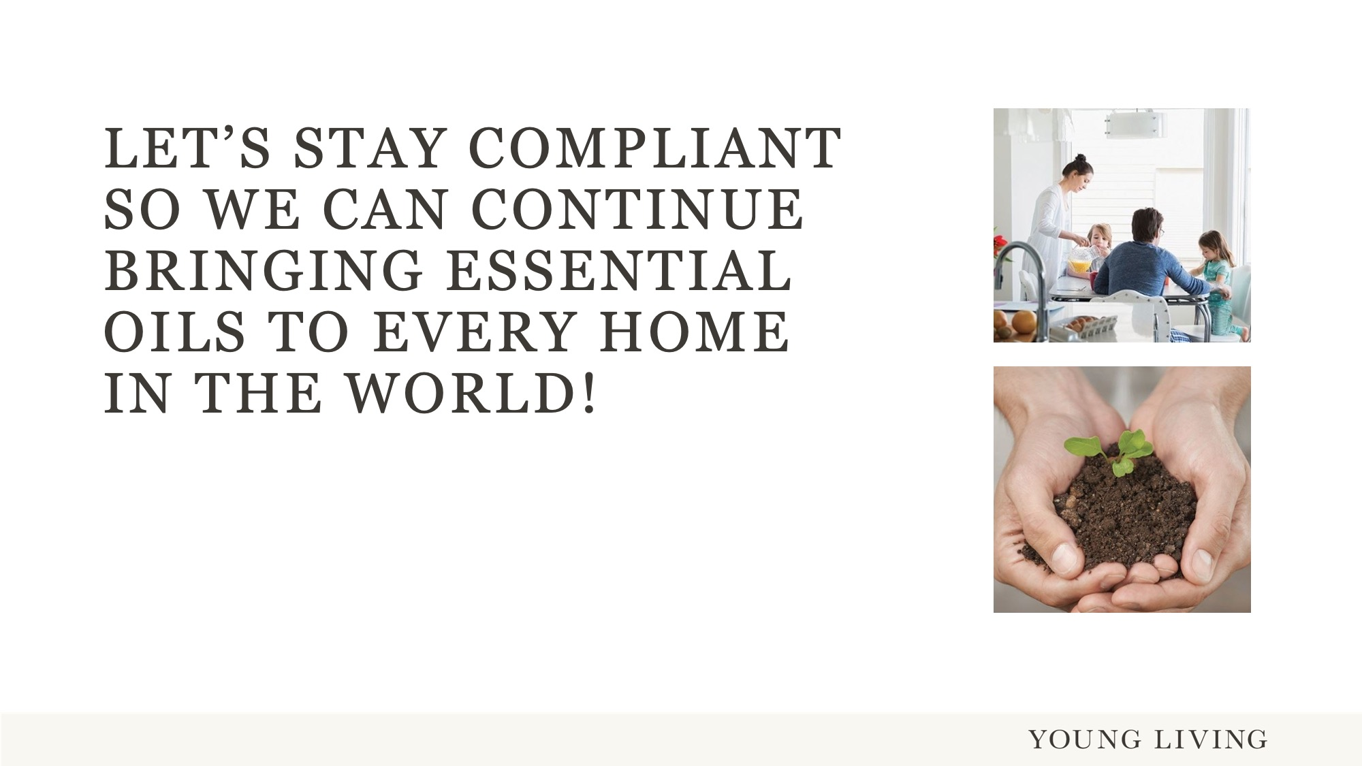
Notes:
Thank you for your attention!

