Slide 1
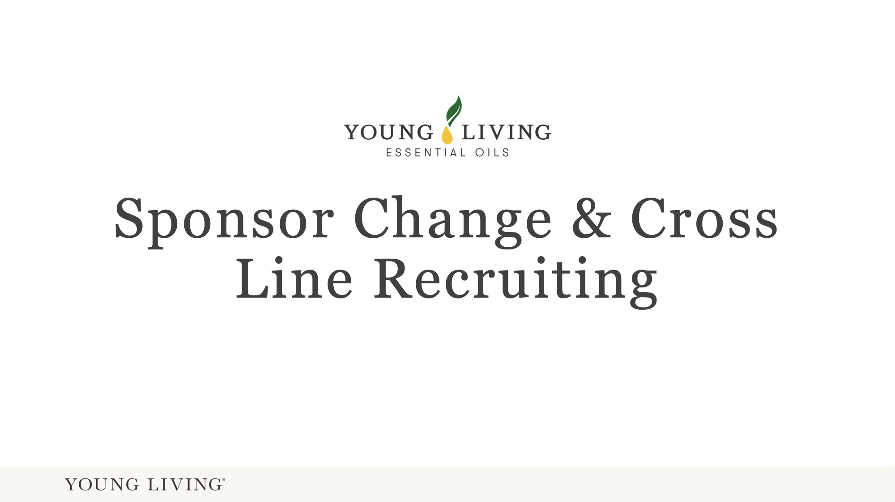
Notes:
This presentation is suitable for newly sign up Brand Partners and experiences Brand Partner. It is explained how to initiate a compliant sponsor change and what to look our for to avoid cross line recruiting and being cross line recruited.

Slide 2
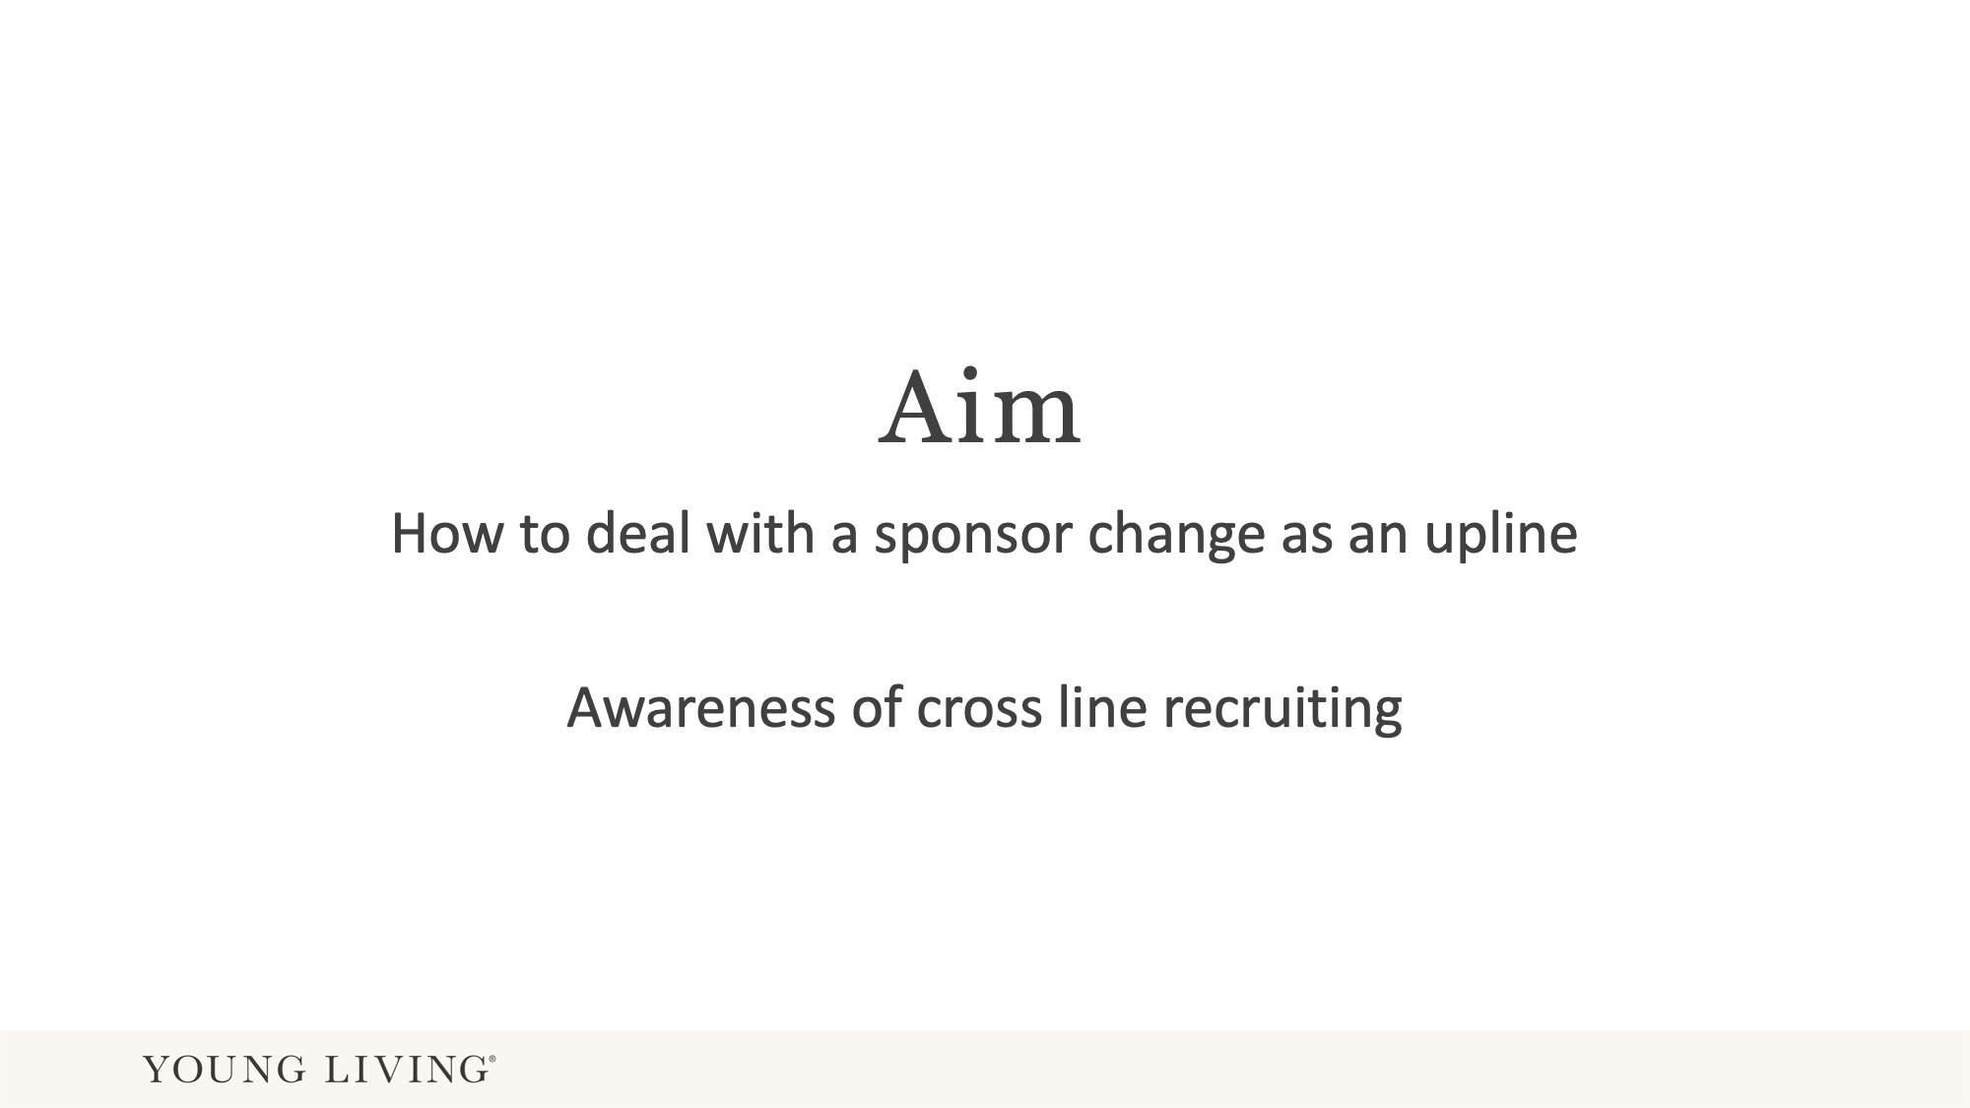

Slide 3
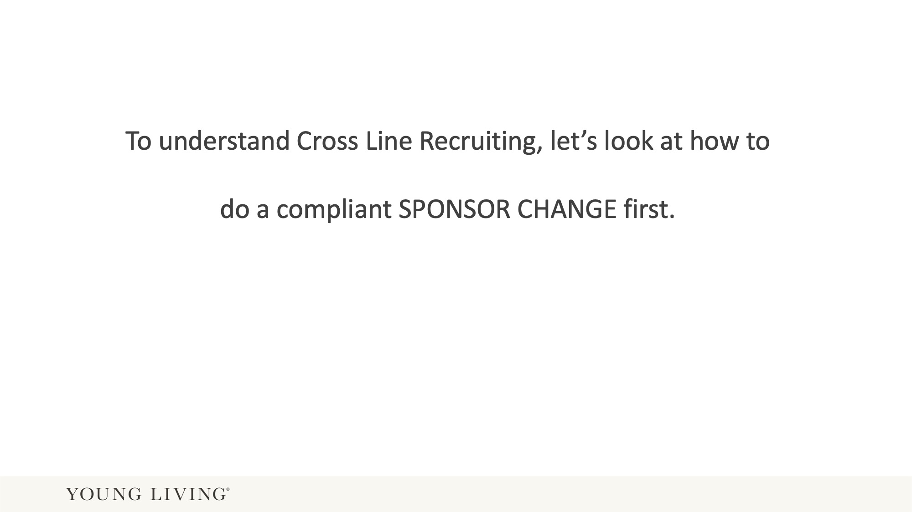

Slide 4
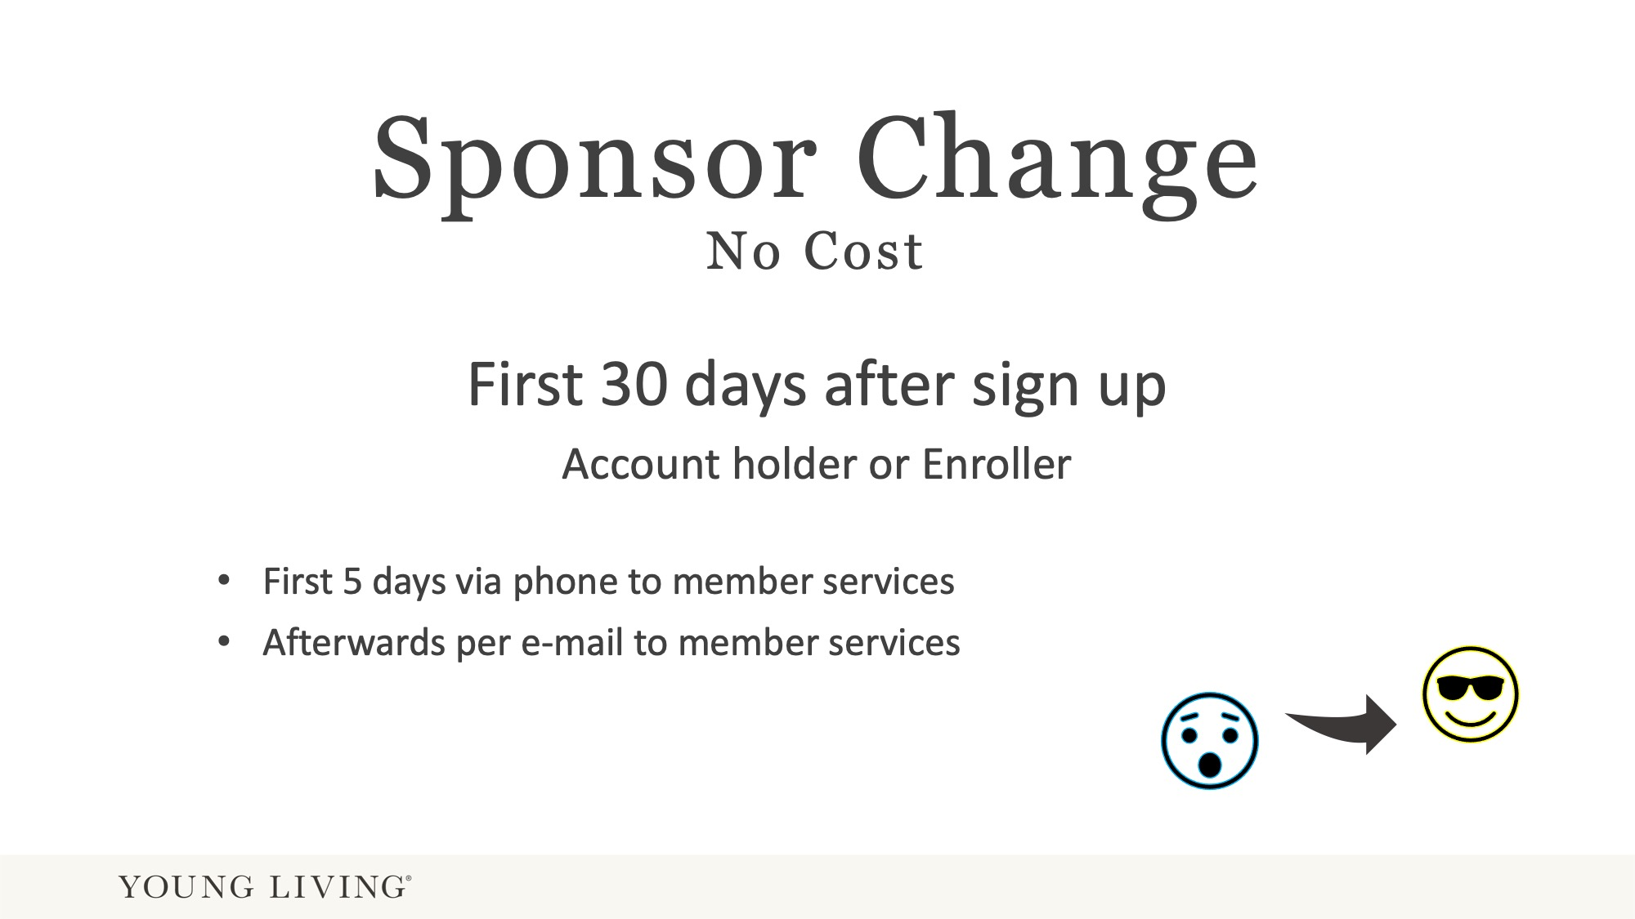
Notes:
It is important to point out that it is the Enroller and not the Sponsor who an apply for the 30 day sponsor change.

Slide 5
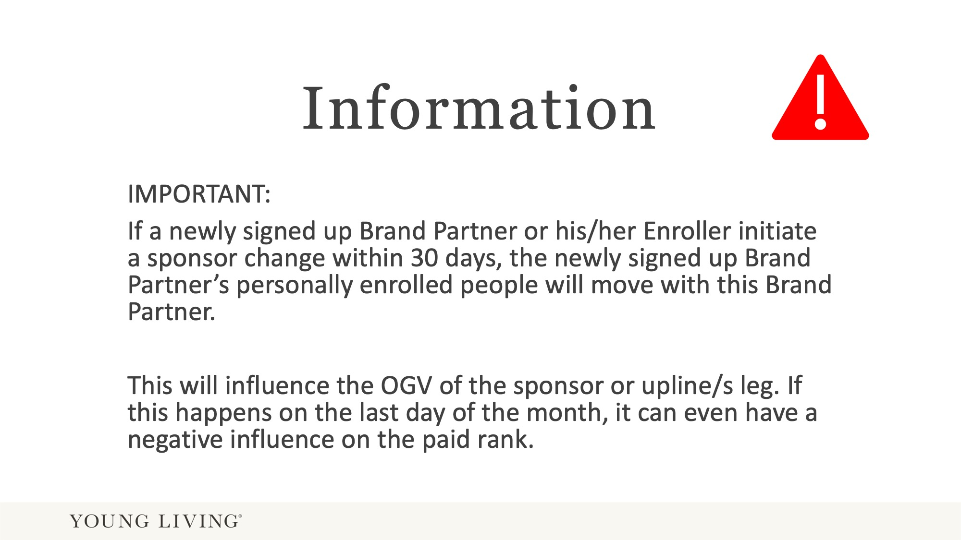
Notes:
This means, if the new BP is the enroller of 5 people, then these 5 people will also move with the BP to the new organisation.
It can effect the paid rank negatively, if all of a sudden OGV are missing from an upline’s leg.
Sponsor changes must be made prior to the end of each calendar month to be recognised in that month. If the Sponsor change is submitted after the last calendar day of the month but within the 30 days of enrolment, the Sponsor change will not be recognized until the following month.

Slide 6
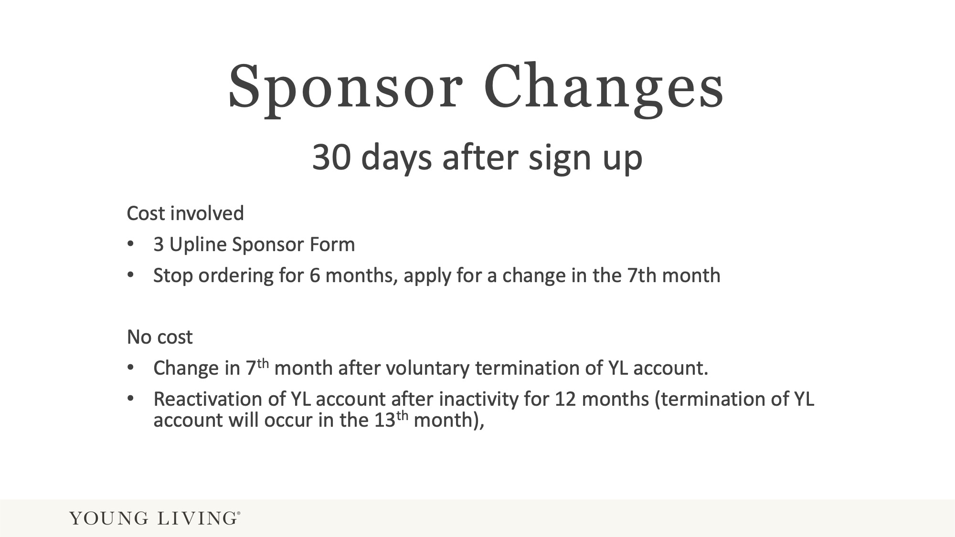
Notes:
Inactivity means “not having ordered for at least 50PV in the last 12 months”.

Slide 7
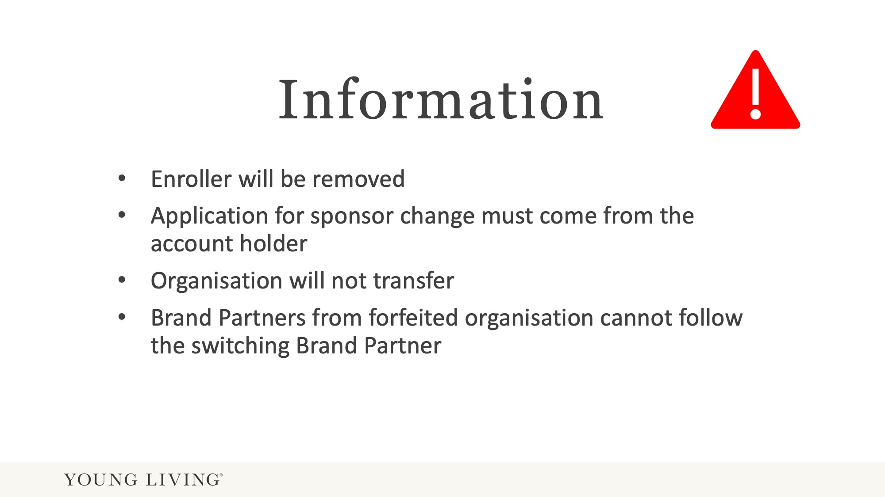
Notes:
Enroller will stay only if the Enroller is still a direct upline in the organisation.

Slide 8
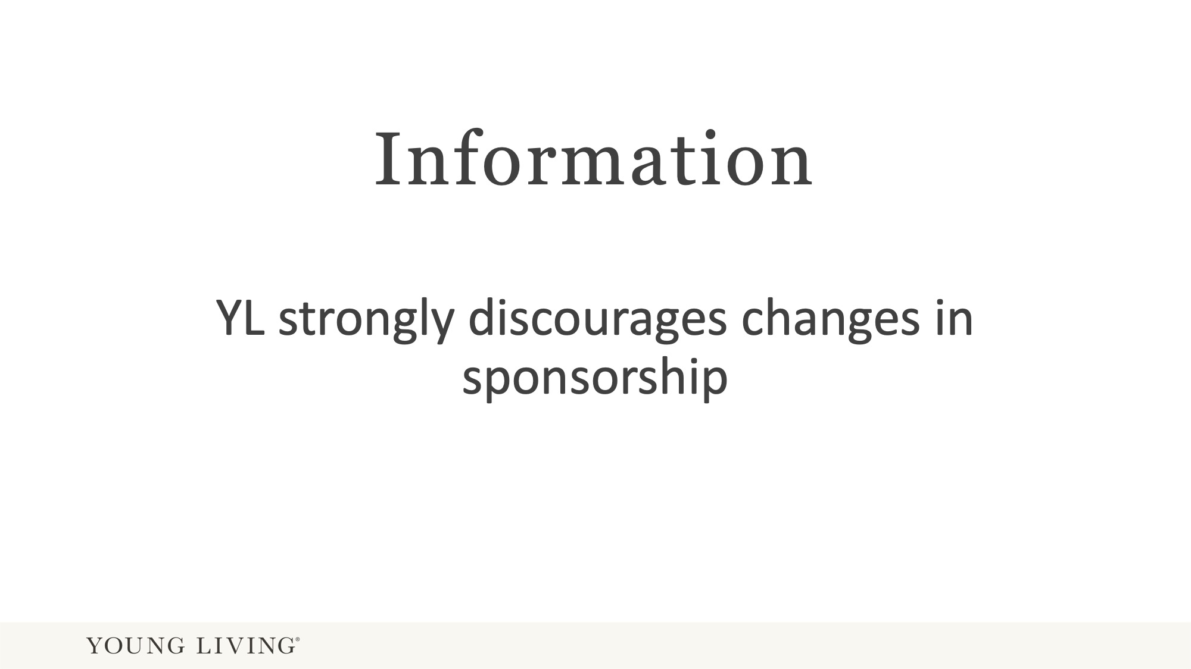
Notes:
YL understands that there are circumstances where a sponsor change is necessary however.

Slide 9
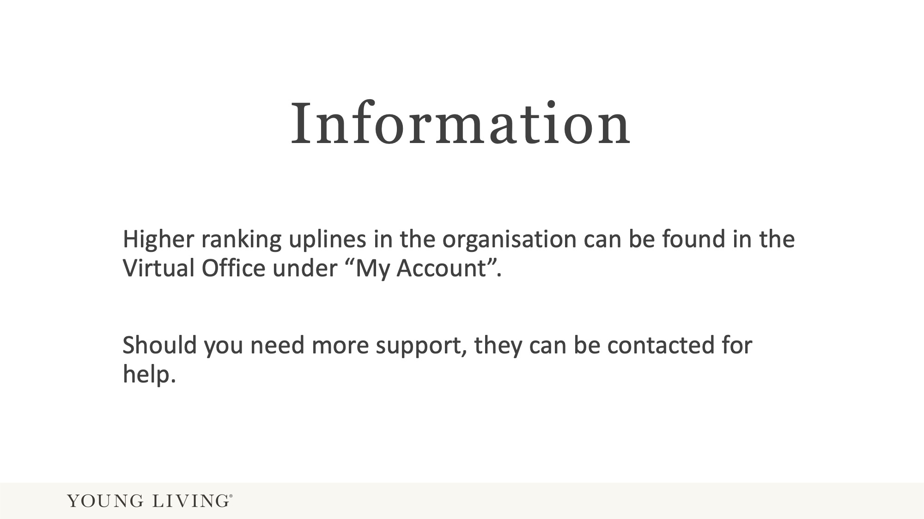

Slide 10
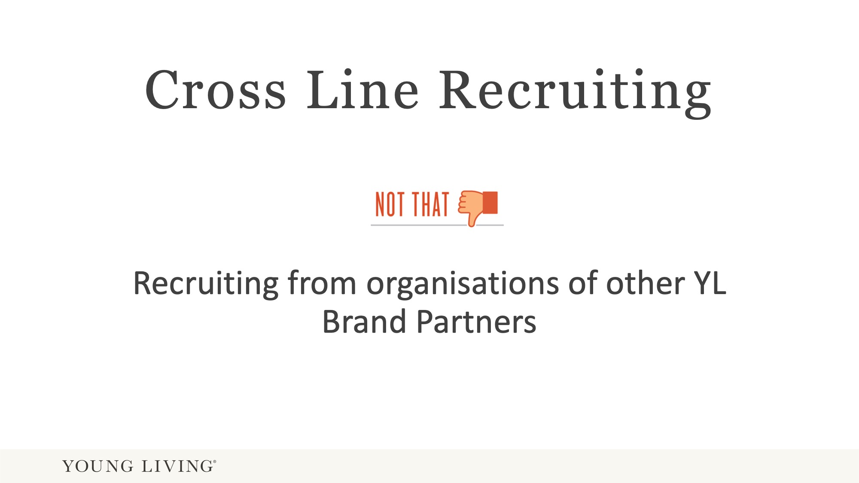
Notes:
Encouraging a YL Brand Partner (directly or indirectly) from another organisation to join your organisation is the definition of cross line recruiting.

Slide 11
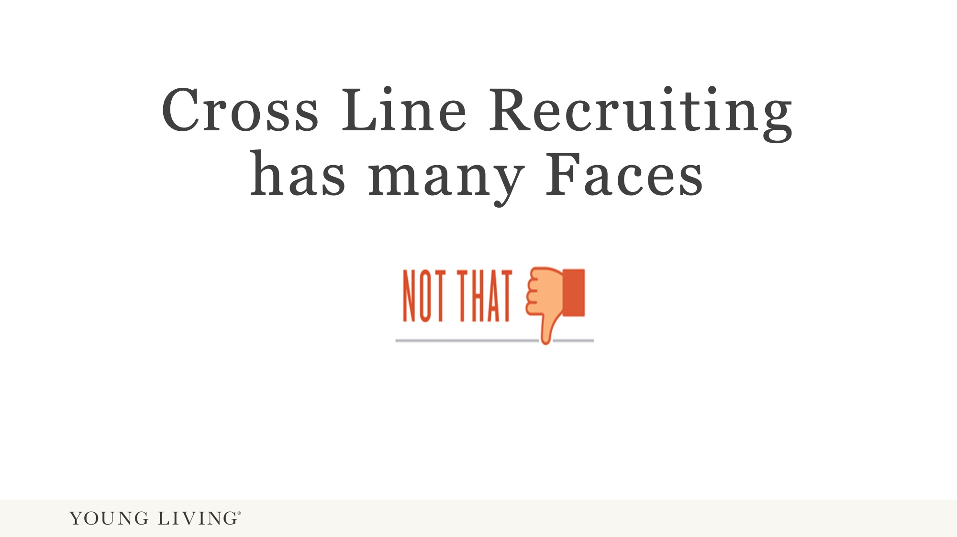
Notes:
It can happen unintentionally or deliberately. There will be examples of unintentional cross line recruiting on the following slides.

Slide 12
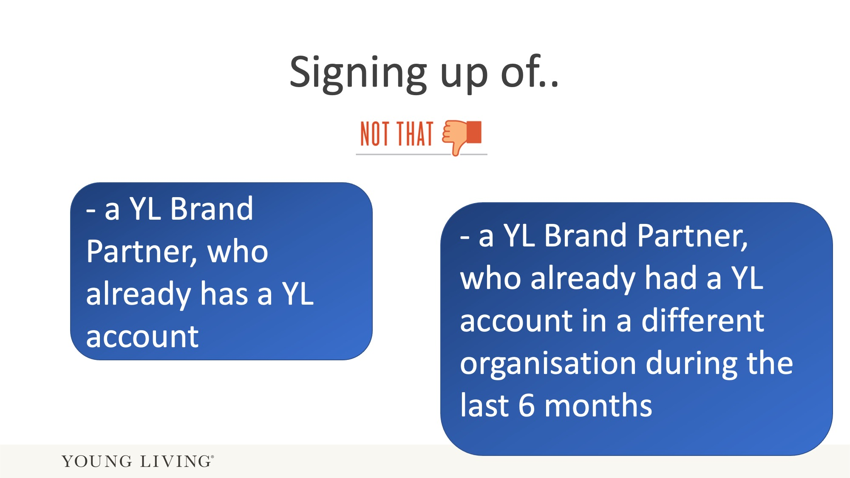
Notes:
Cross line recruiting very often happens in conjunction with opening a duplicate account, or getting someone to come to your organisation who already had a YL account during the last 6 months.

Slide 13
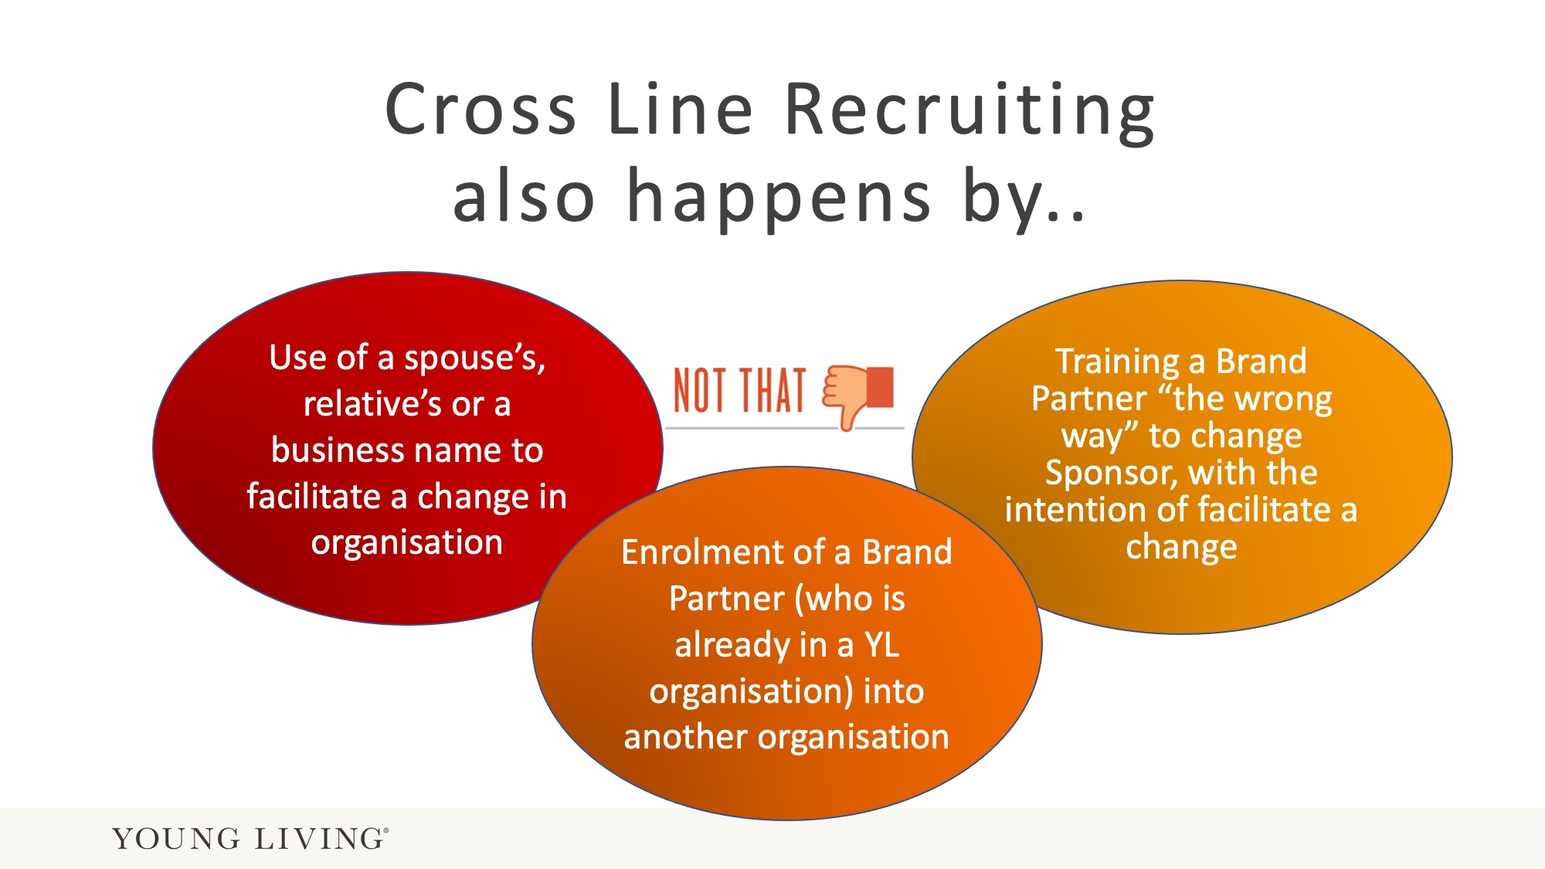
Notes:
The first two examples (use of spouse’s name and “enrolment”) actually contain two breaches of the YL policy. The first is the cross line recruiting action from a Brand Partner in a different organsiation. The second breach is from the Brand Partner who is being recruiting, by opening a duplicate account.

Slide 14
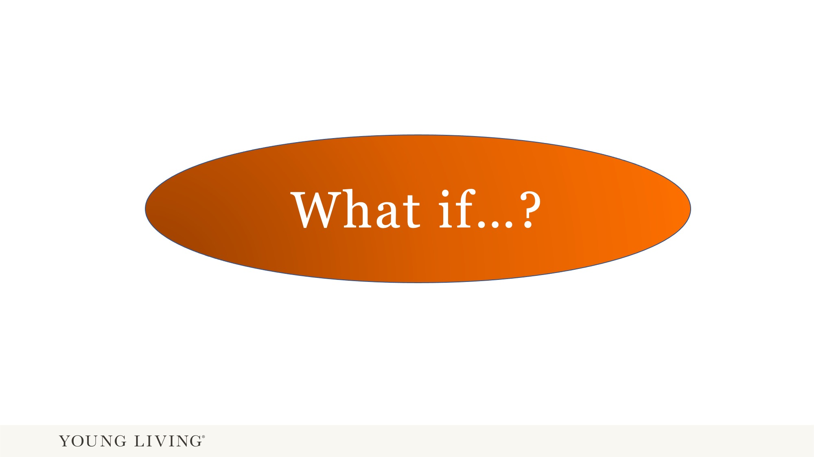
Notes:
“What if” the following situation happens. Here the promised examples.

Slide 15
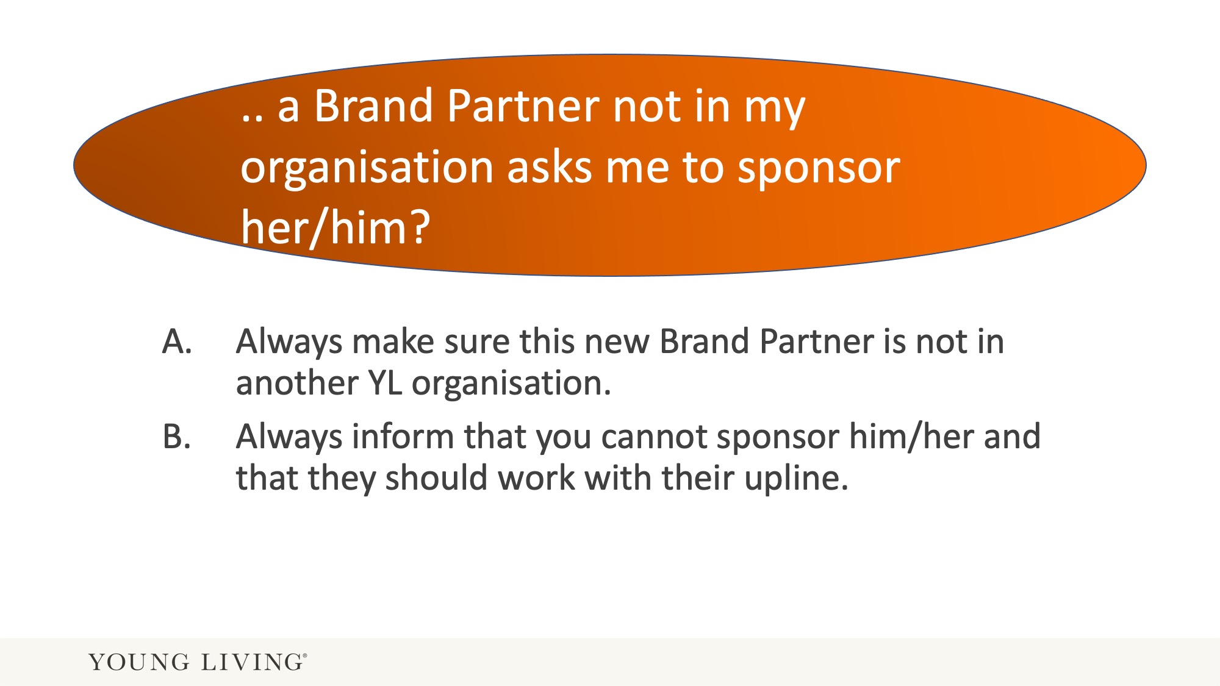
Notes:
Tip for leaders:
It is always wise to ask if a potential Brand Partner already had contact with another YL Brand Partner or already has a YL account.

Slide 16
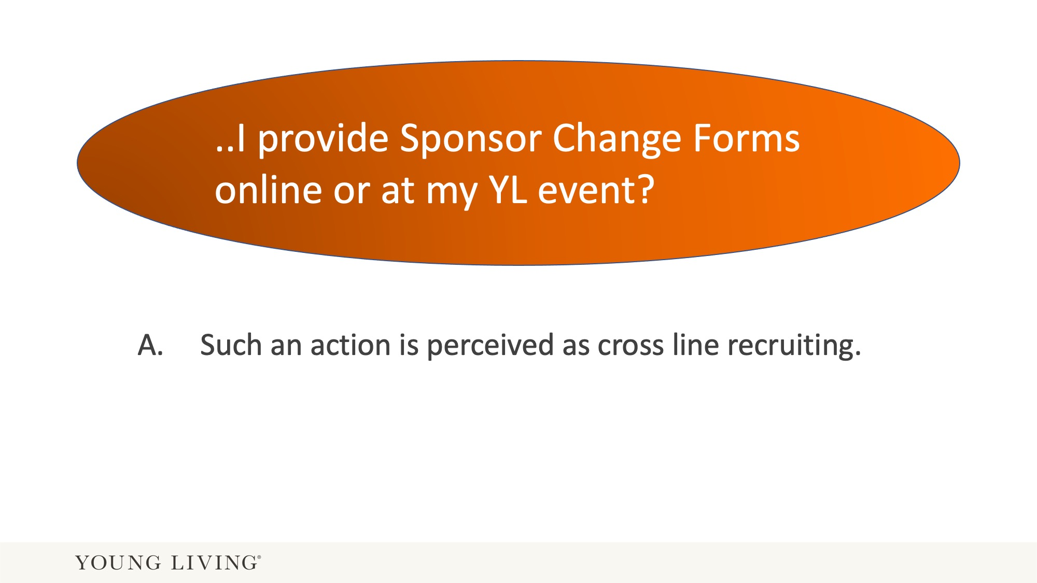
Notes:
This is an “indirect” attempt of cross line recruiting.

Slide 17
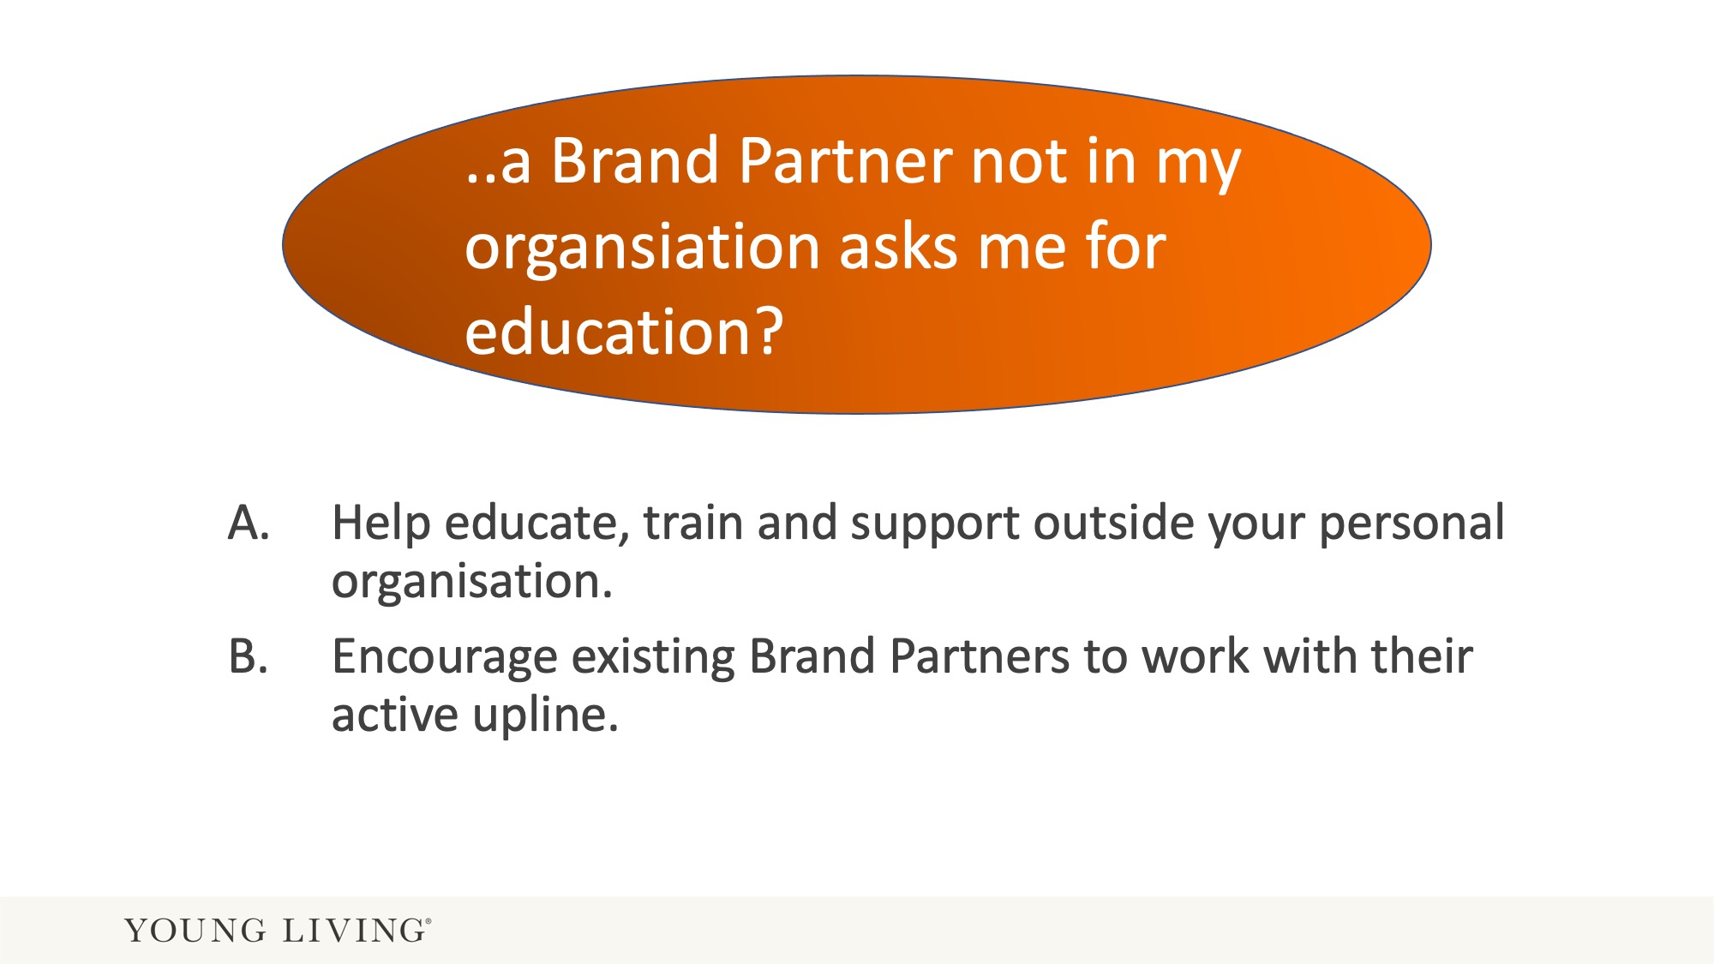
Notes:
If a Brand Partner is not happy with their upline, it is best to refer this Brand Partner to Member Service for more information. It is not advisable to describe of how to change to a new sponsor.

Slide 18
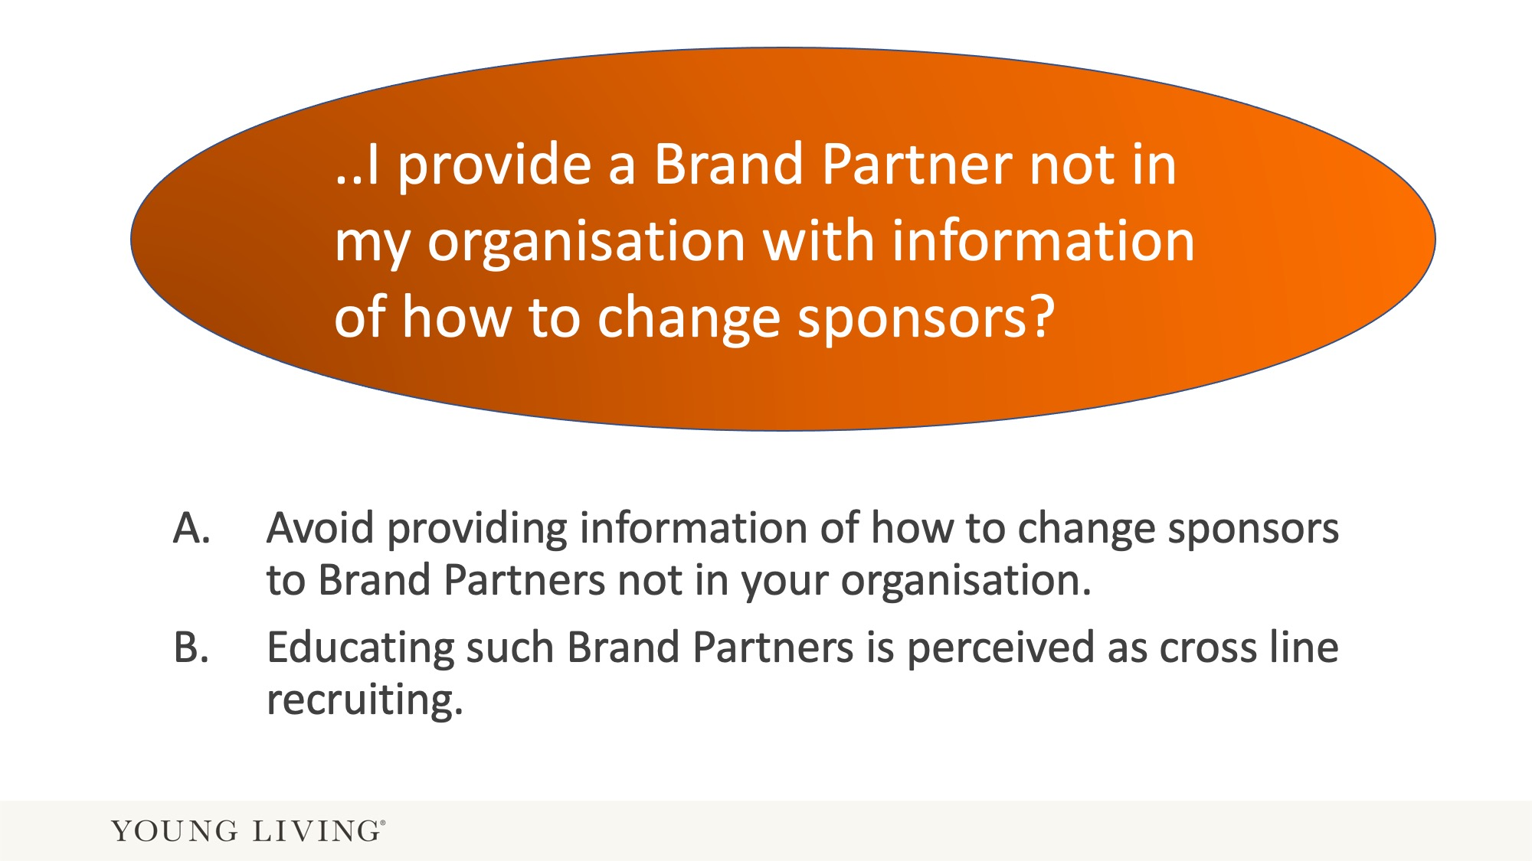
Notes:
It is not advisable to describe of how to change to a new sponsor. It can very easily be interpreted from the “old” organisation that this Brand Partner was cross line recruited.

Slide 19
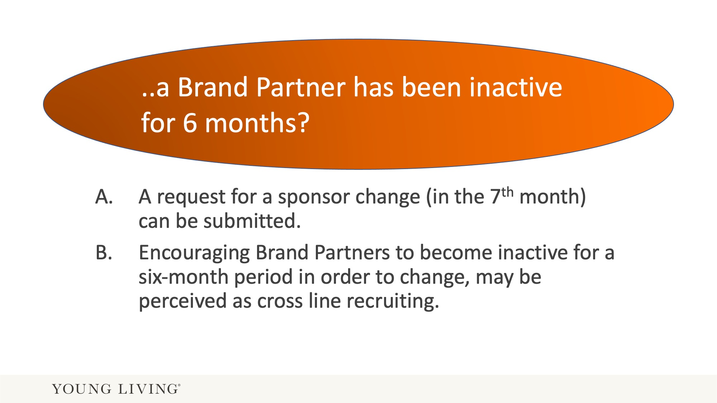

Slide 20
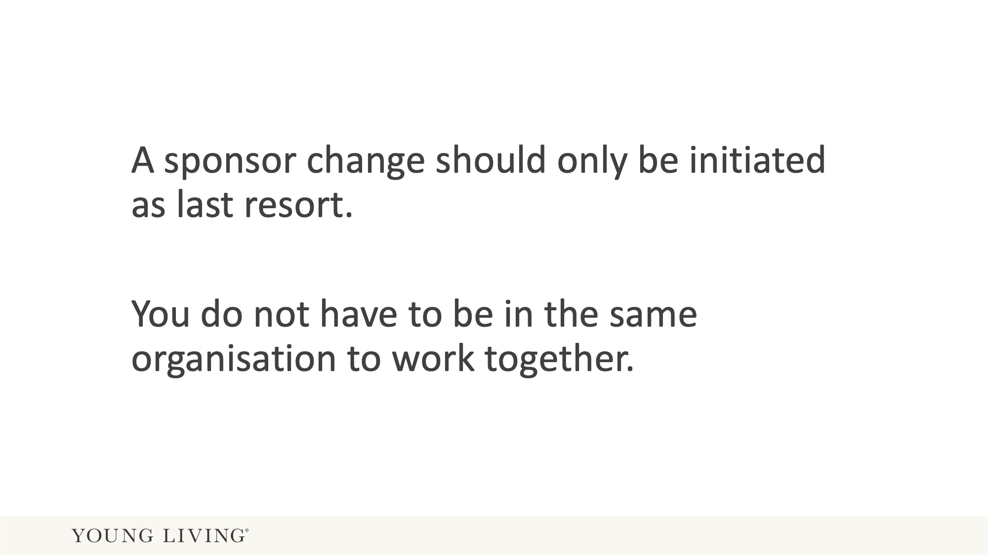

Slide 21
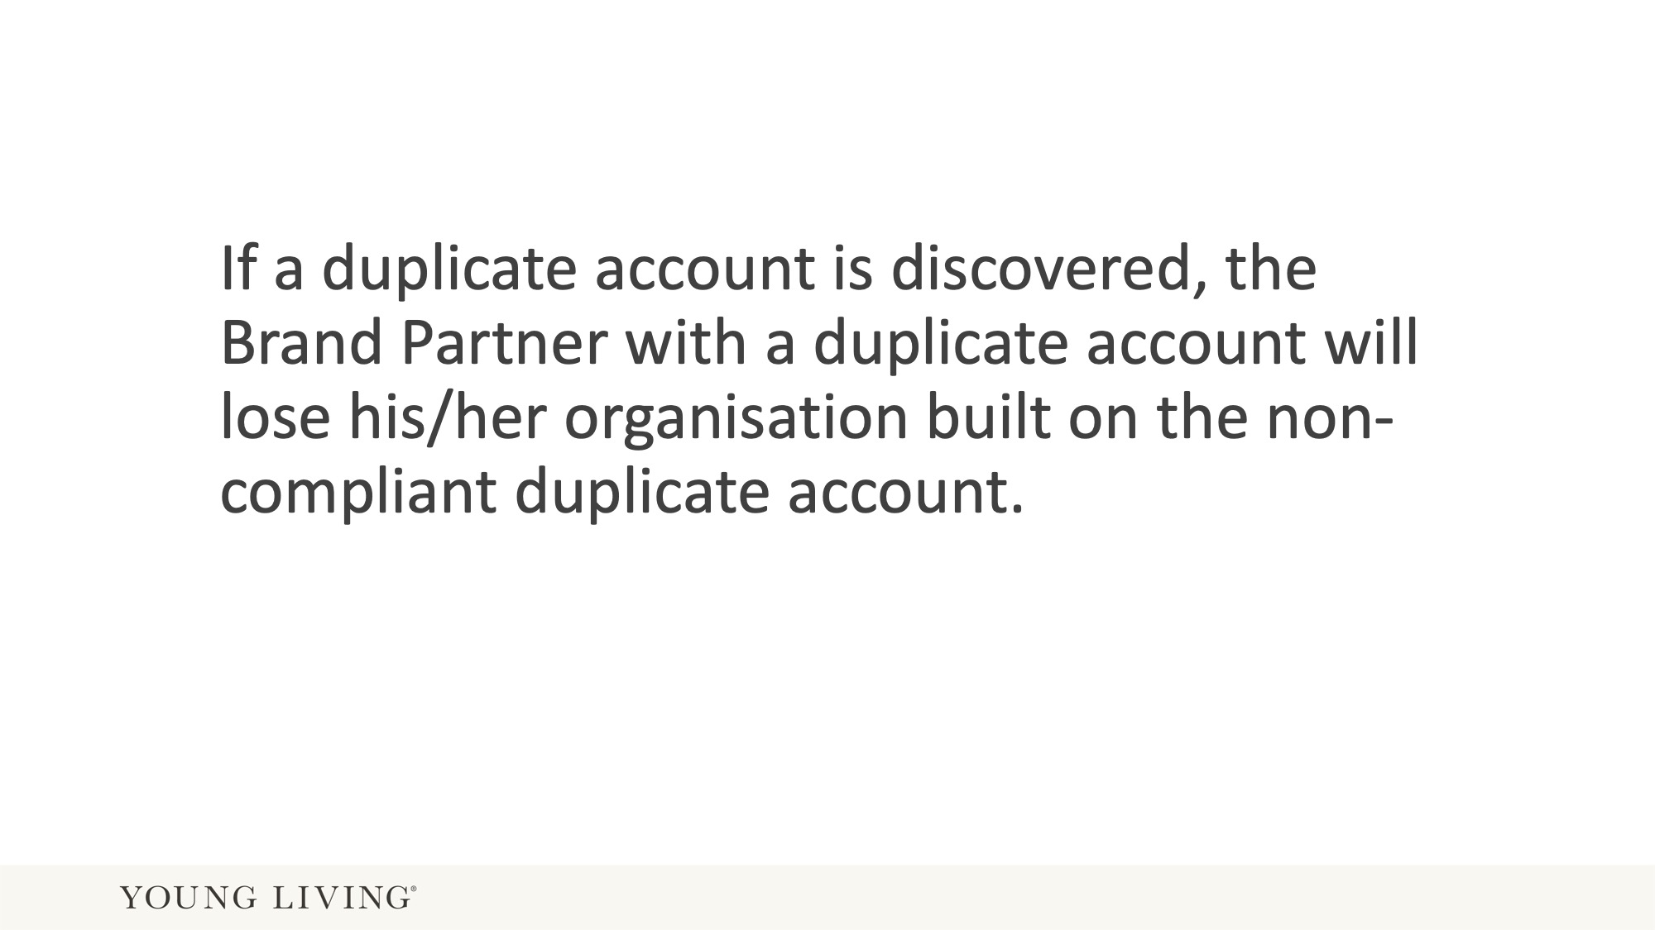

Slide 22


