Slide 1
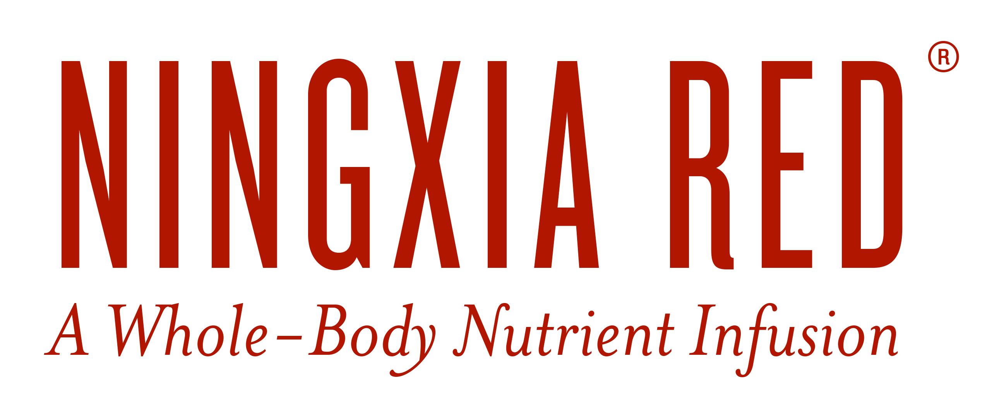

Slide 2

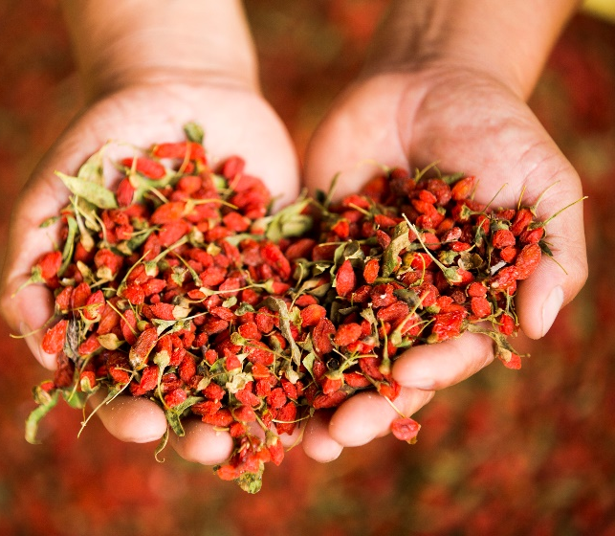
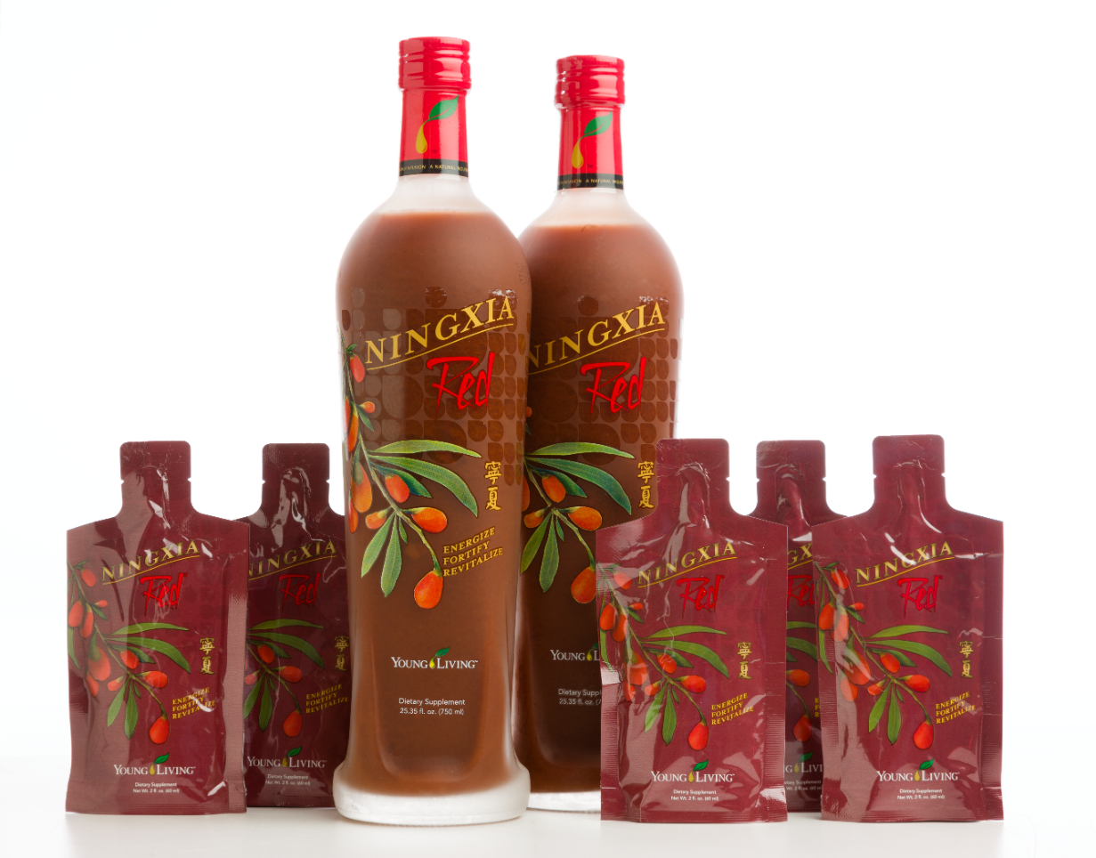
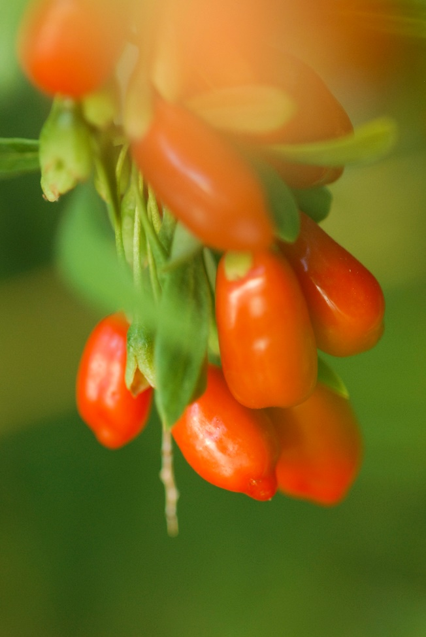
Notes:
NingXia Red is one of Young Living’s most popular wellness product. It’s a nutrient-rich drink infused with antioxidant-providing superfruits and powerful essential oils. NingXia Red contains vital nutrients that may be missing or low in some modern diets and that could be the key to experiencing abundant wellness and energy. It is the perfect way to start the day.

Slide 3
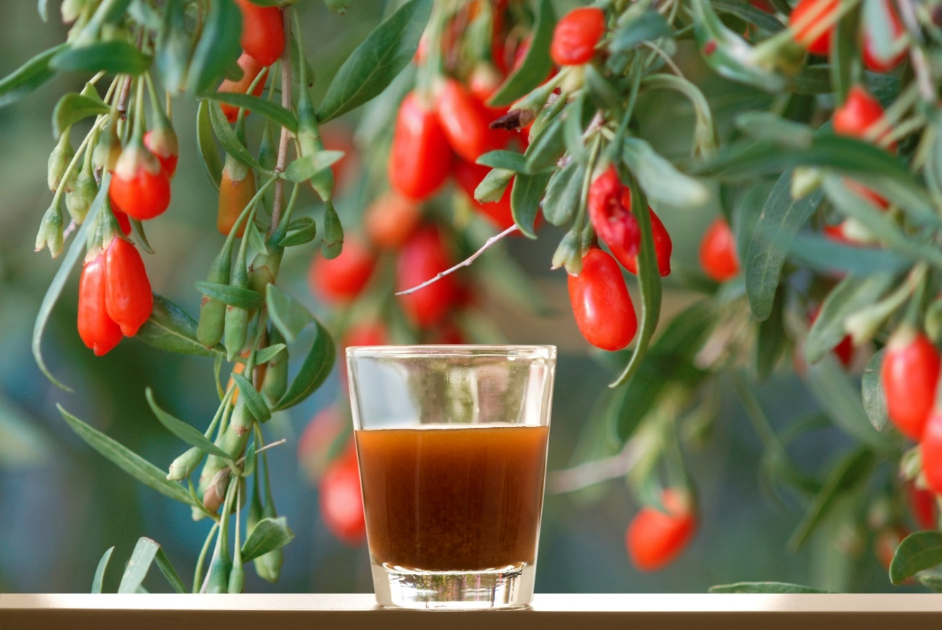

ENERGIZE.FORTIFY.REPLENISH.
Notes:
NingXia Red energizes, fortifies, and replenishes the body and mind with a proprietary blend of pure essential oils and wolfberry, a known provider of antioxidants. Other vitamin-rich superfoods in NingXia Red supply the body with vital antioxidants and phytonutrients for a whole-body nutrient infusion.

Slide 4
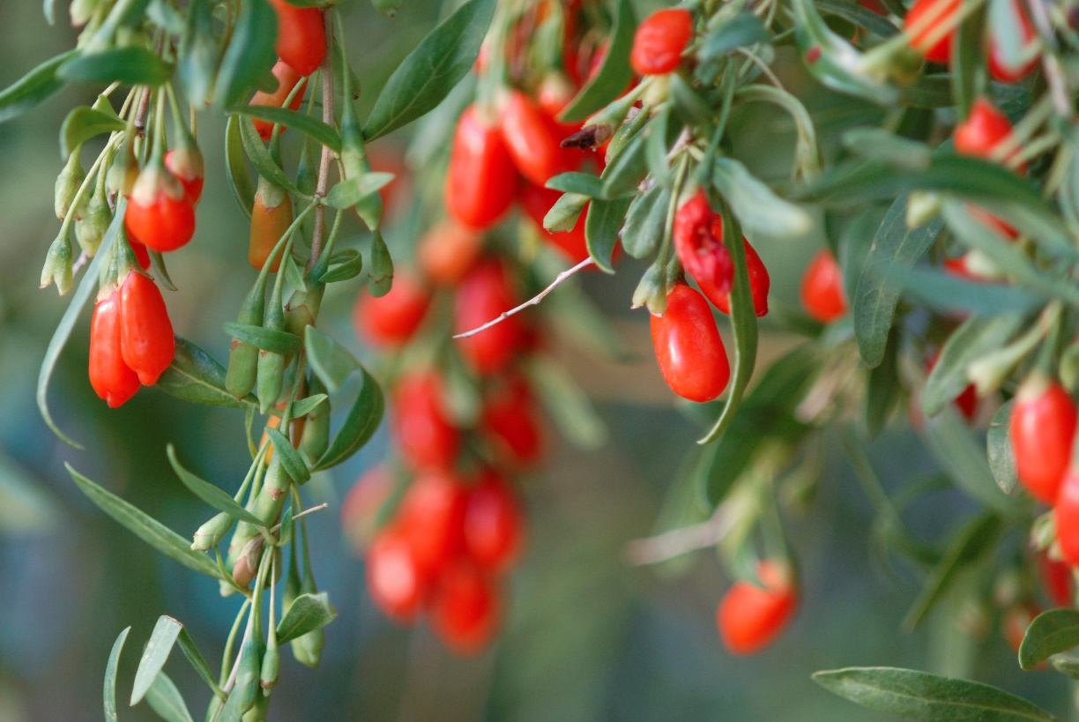
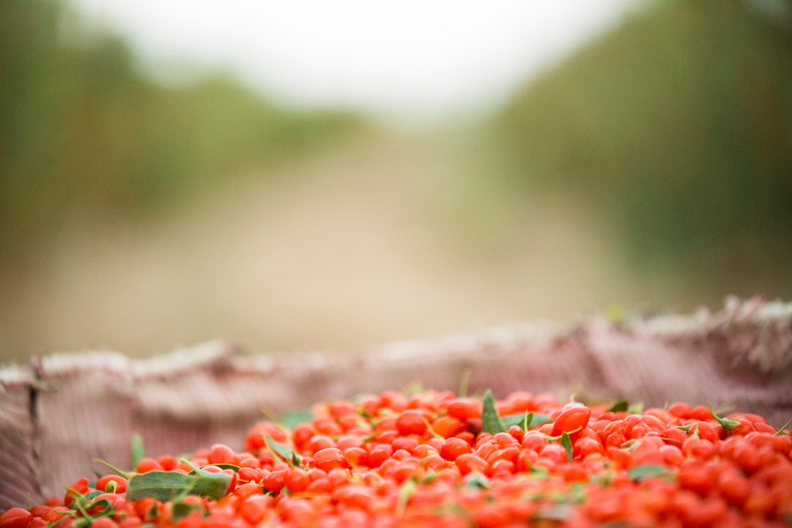
WHAT ARE ANTIOXIDANTS?
Notes:
One of the many reasons to drink NingXia Red is that it supplies the body with important antioxidants.
Antioxidants are nutrients, such as vitamins, minerals, and enzymes, that help fight off the effects of free radicals. The body experiences a natural phenomenon called oxidation every day, which can produce harmful byproducts called free radicals. These free radicals may damage cells, much like the chemical reaction that takes place when a half-eaten apple turns brown. Free radical exposure can be increased by pollution, stress, toxins, smoking, and alcohol.

Slide 5

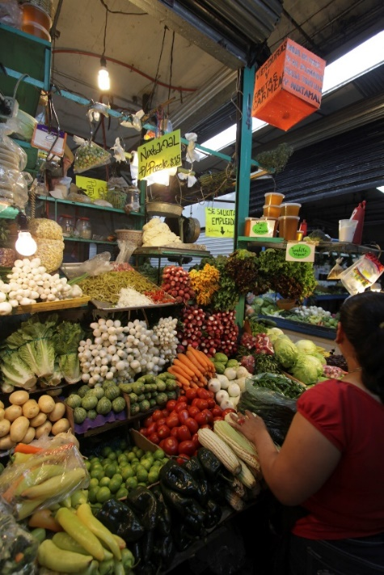
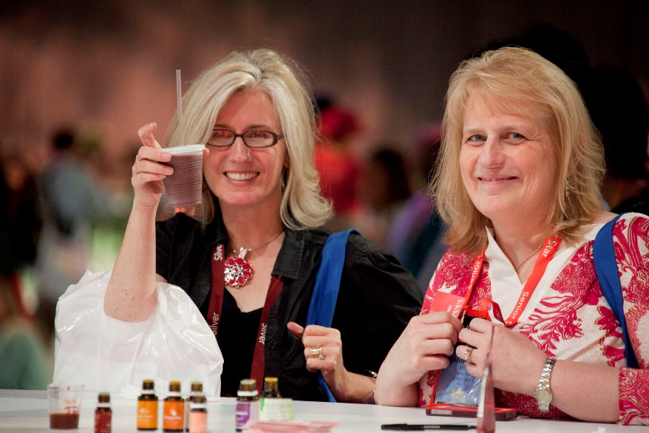
ANTIOXIDANT BALANCE
Notes:
NingXia Red offers a broad spectrum of antioxidants and phytonutrients.
Antioxidants are beneficial for optimal health, but you don’t need high amounts of any one antioxidant, no matter how powerful it is. To create the best defense against free radicals, the body needs an array of many different antioxidants. The key to optimal support is balance. Just as a healthy diet consists of a variety of fruit and vegetables, antioxidant supplementation also needs to come from a variety of sources to support optimal health.

Slide 6
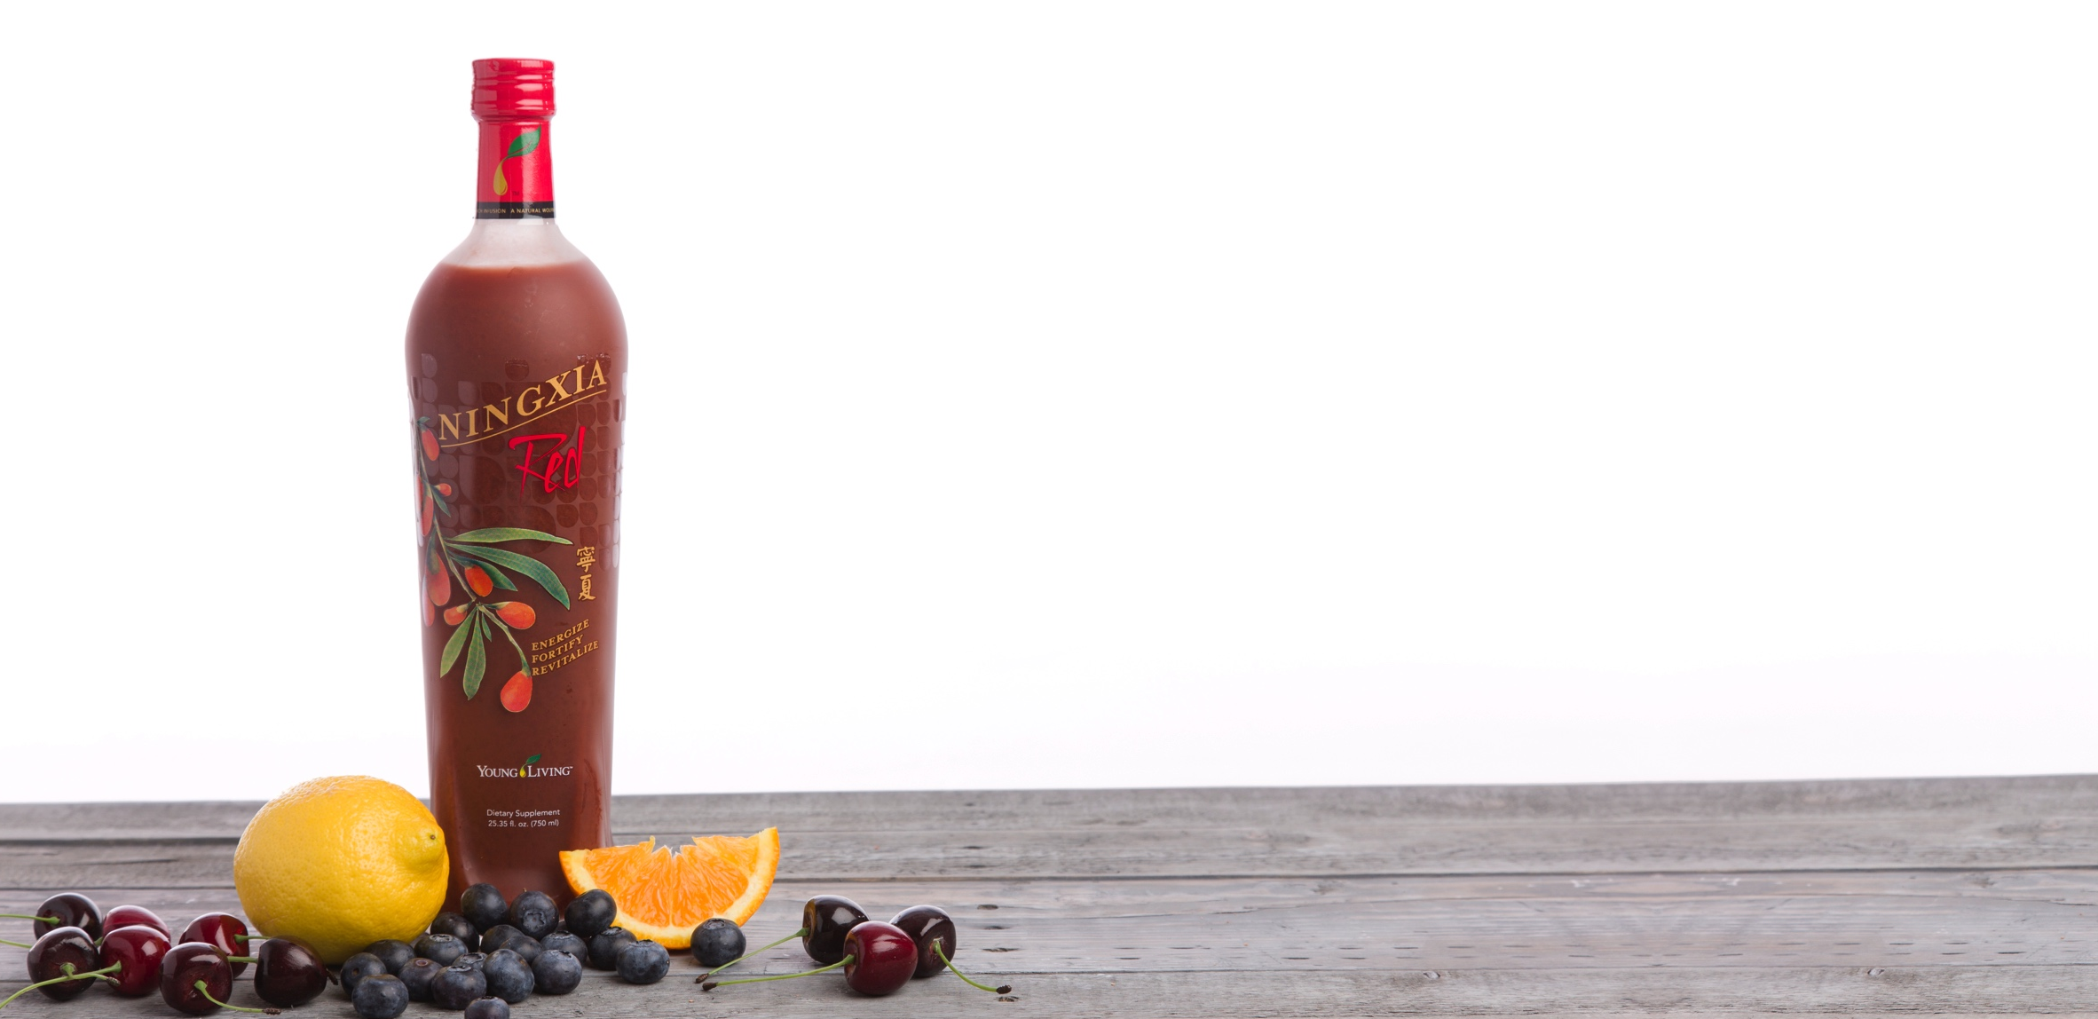
WHOLE-BODY NUTRIENT INFUSION
Wellness from head to toe
Anthocyanins
Boron
Calcium
Catechin gallate
Copper
Iron
Lycopene
Magnesium
Manganese
Phenols
Potassium
Sodium
Tocopherols
Tocotrienols
Vitamin C
Zinc
Notes:
NingXia Red offers a range of antioxidants that supports the entire body. This balanced approach to antioxidant supplementation is why so many people experience energy, vitality, and vigor when they start using this product. NingXia Red:
Contains balanced ingredients that make it a whole-body nutrient infusion for health and wellness support.
Contains powerful ingredients that are involved in many natural antioxidant processes.
Delivers citrus essential oils containing d-limonene, a powerful component in citrus oils.
Utilizes a powerful formula that includes wolfberry, which is touted for its health benefits.
Is a healthy daily beverage

Slide 7
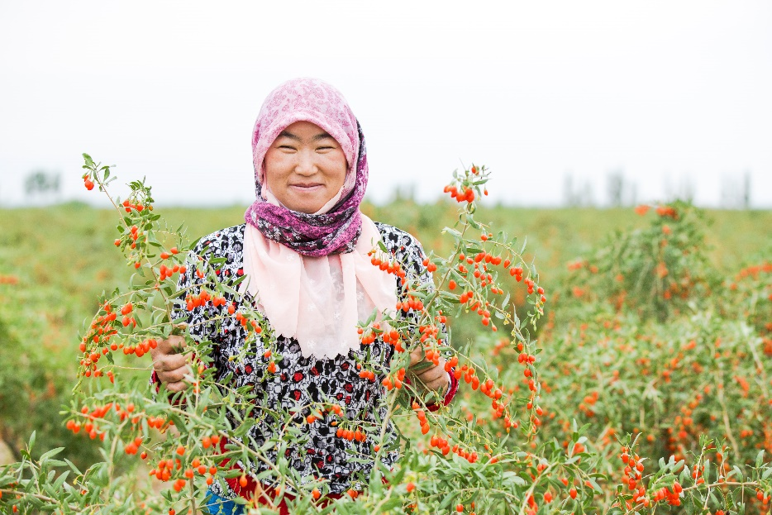
WOLFBERRY
NingXia Red is made with whole-fruit wolfberry puree.
Wolfberries contain every essential amino acid.
With 13 percent protein content, wolfberries offer one of the highest protein levels of any fruit.
Notes:
NingXia Red contains the puree from the whole Ningxia wolfberries. We use all of the valuable parts—the juice, peel, seeds, and fruit—to ensure that each bottle contains the optimal blend of nutrients offered by this extraordinary fruit.
Our wolfberry comes from the Ningxia Province in northern China, where it has been revered for centuries. It contains every essential amino acid and contains 13 percent protein, the highest protein content of any fruit. Ongoing research continues to support the wolfberry’s nutritional properties.

Slide 8
ESSENTIAL OILS
Tangerine
Orange
Yuzu
Lemon
Notes:
The NingXia Red formula also uses essential oils, another distinctive feature of this unique product. Orange, Tangerine, Lemon, and Yuzu essential oils, all containing rich and powerful d-limonene, enhance the flavor of every bottle of NingXia Red.

Slide 9

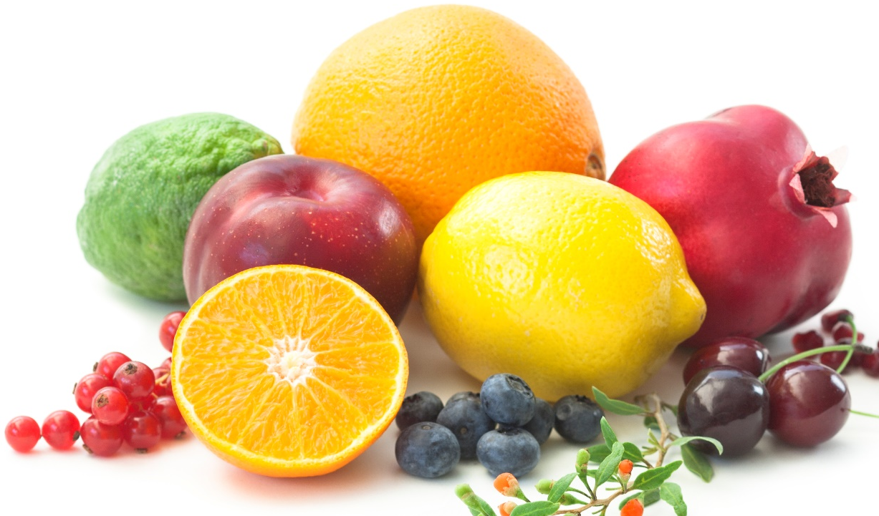
FRUIT BLEND
Wolfberry Puree
Blueberry
Aronia
Cherry
Pomegranate
Plum
Grape
Notes:
NingXia Red contains many nutrient-dense fruits in addition to wolfberry: aronia, blueberry, cherry, pomegranate, and plum. Together, they provide a wide spectrum of antioxidant activity that will energize, fortify, and replenish your body.
These fruits are high in bioflavonoids and phenolic compounds such as anthocyanins and zeaxanthin, each a powerful phyto-nutrient.

Slide 10
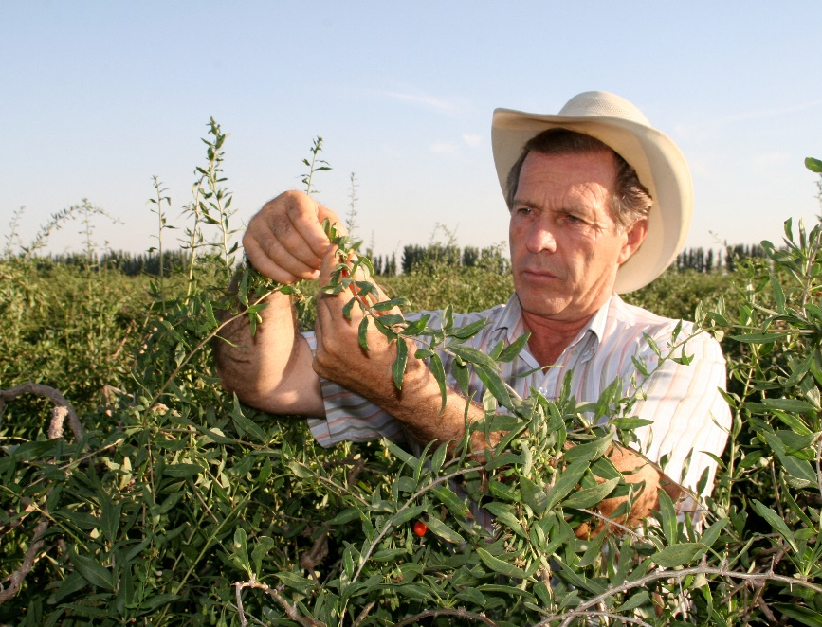
DID YOU KNOW?
NingXia Red is Kosher and
Halal approved.
Young Living uses a patented grape
seed extract.
NingXia Red does not contain processed high-fructose sweeteners.
Notes:
Young Living uses a patented grape seed extract that contains a polyphenolic compound.
NingXia Red is lightly sweetened by a natural, calorie-free stevia extract.

Slide 11
DID YOU KNOW?
Blueberry, cherry, aronia, pomegranate, and plum were carefully selected for their bioactive phytonutrients and ability to support energy.

Slide 12
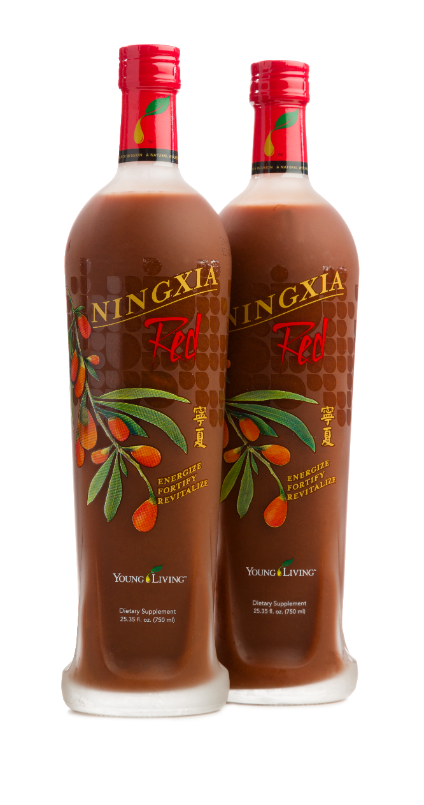
WHAT DOES RED DO FOR YOU?
Supports whole-body health and overall wellness.
Contains d-limonene, a powerful component in citrus oils.
Provides energy support.
Helps prevent against oxidative stress.
Notes:
Ask the audience: “Who has experienced some of the benefits of NingXia Red?”

